Slide 1
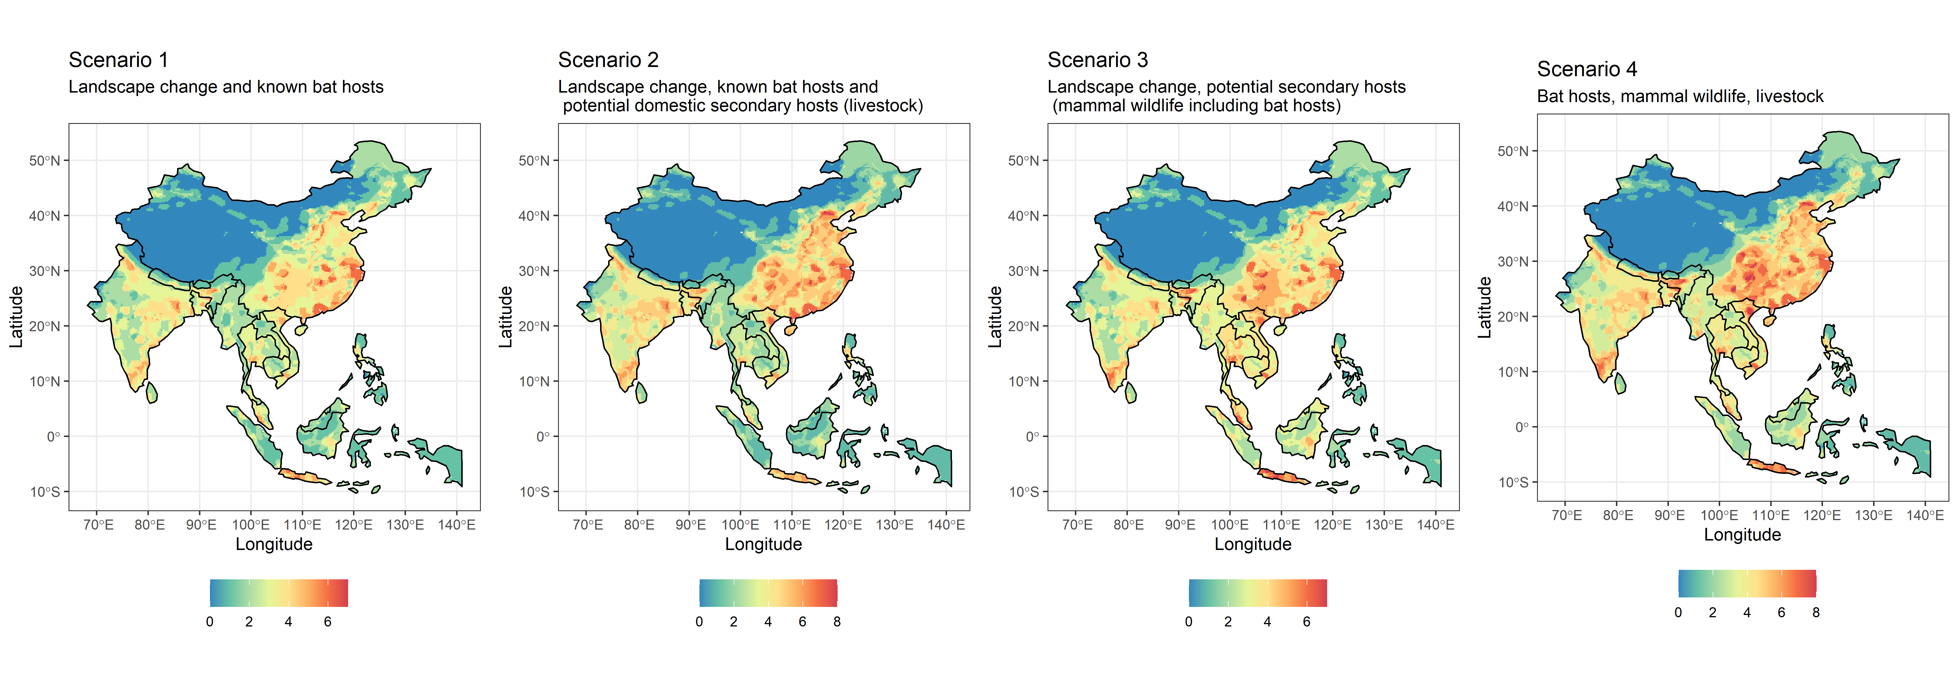
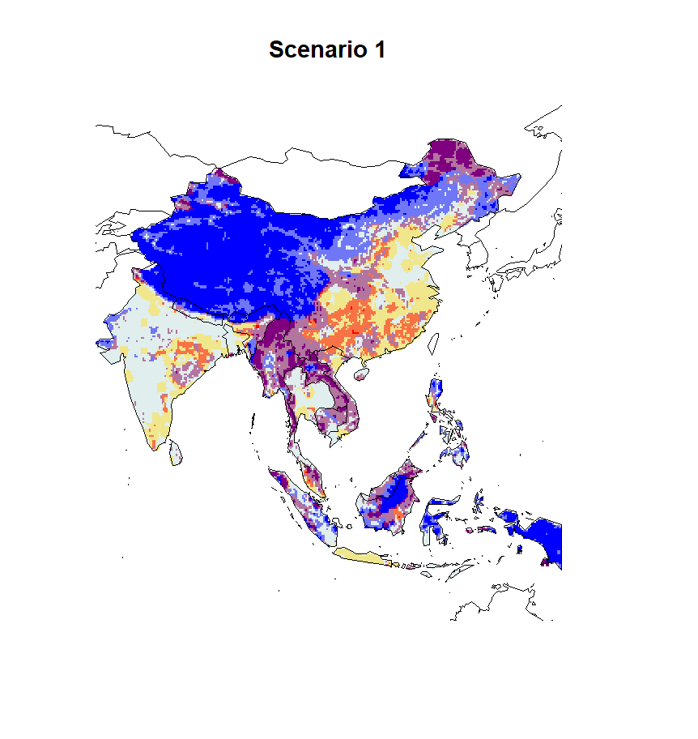


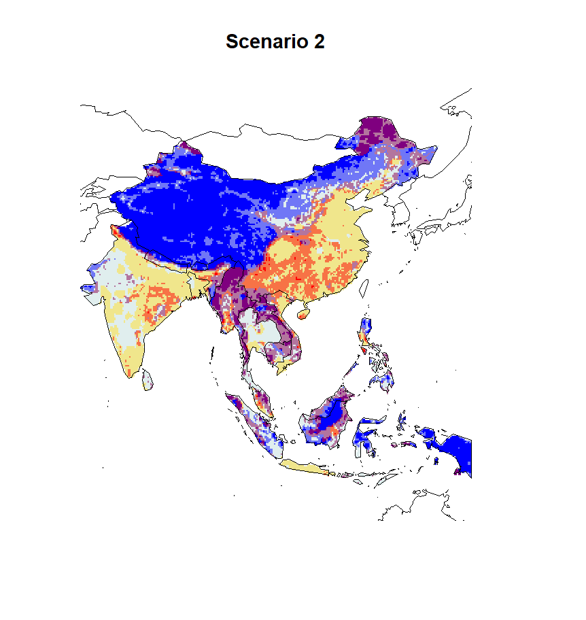

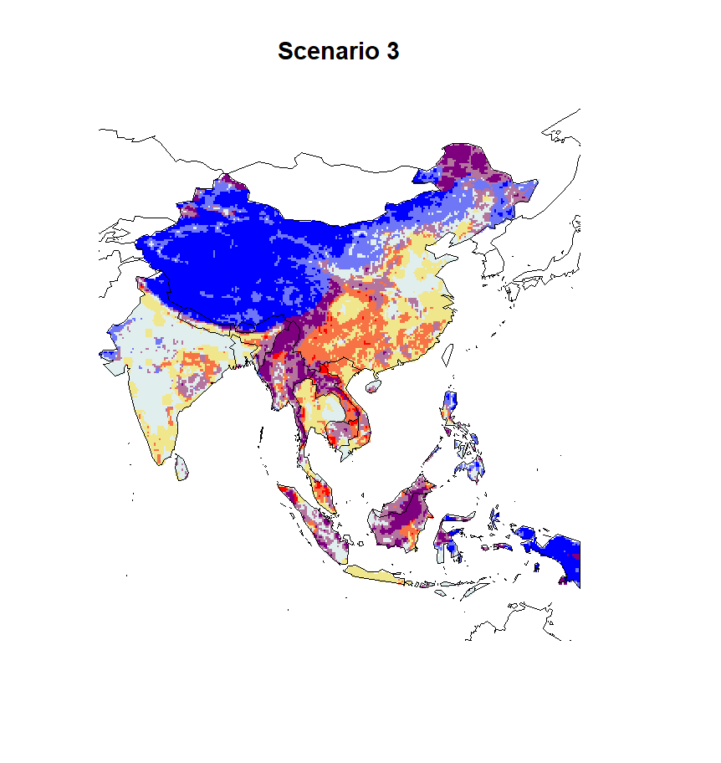
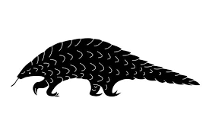
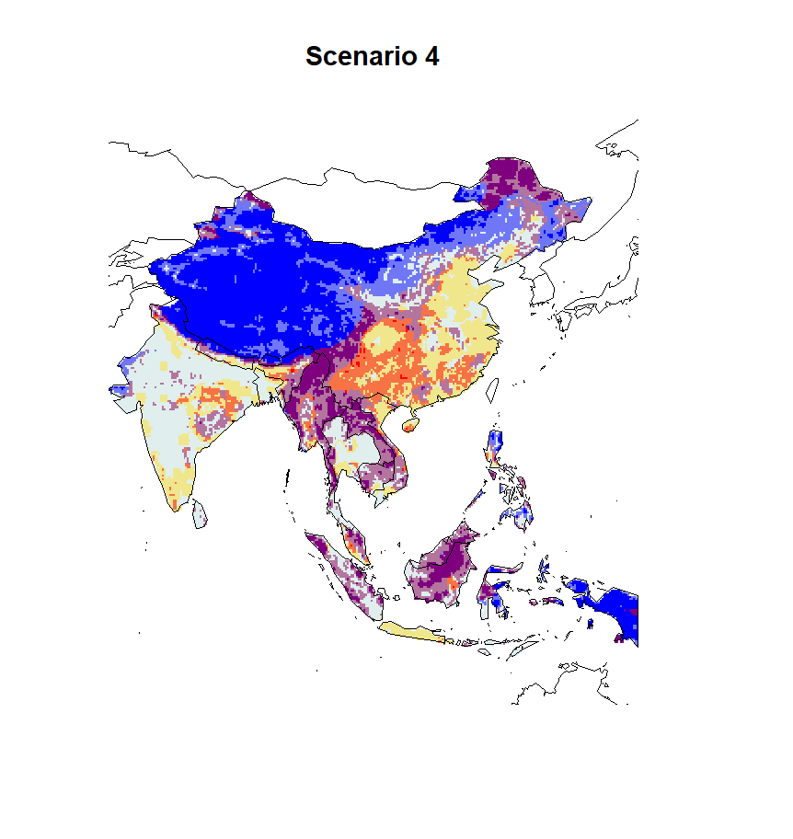
*
*

Slide 3
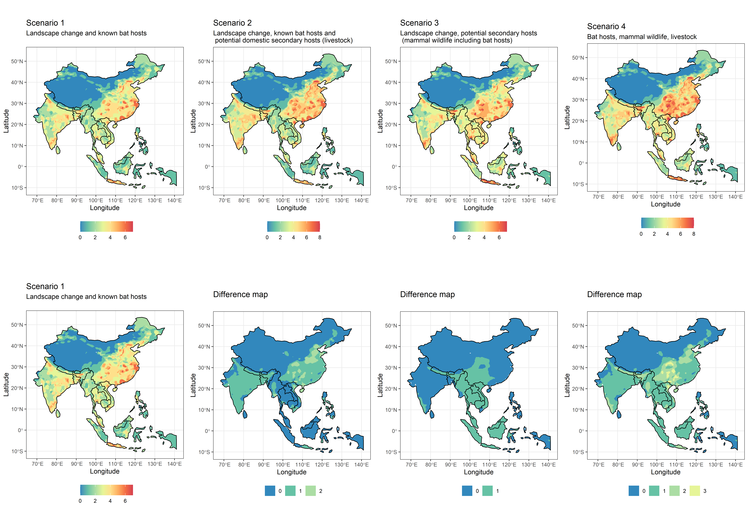

Slide 4
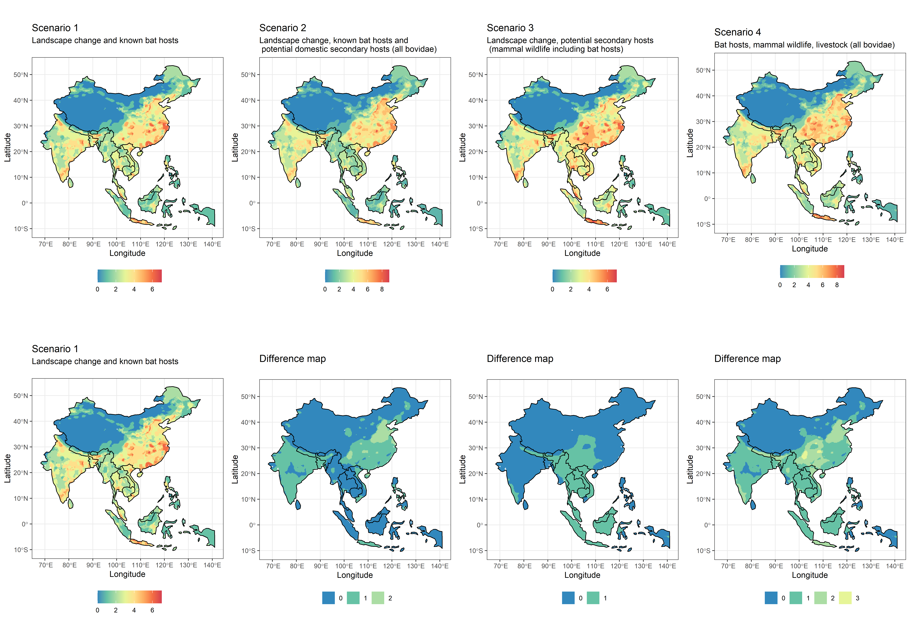

Slide 5
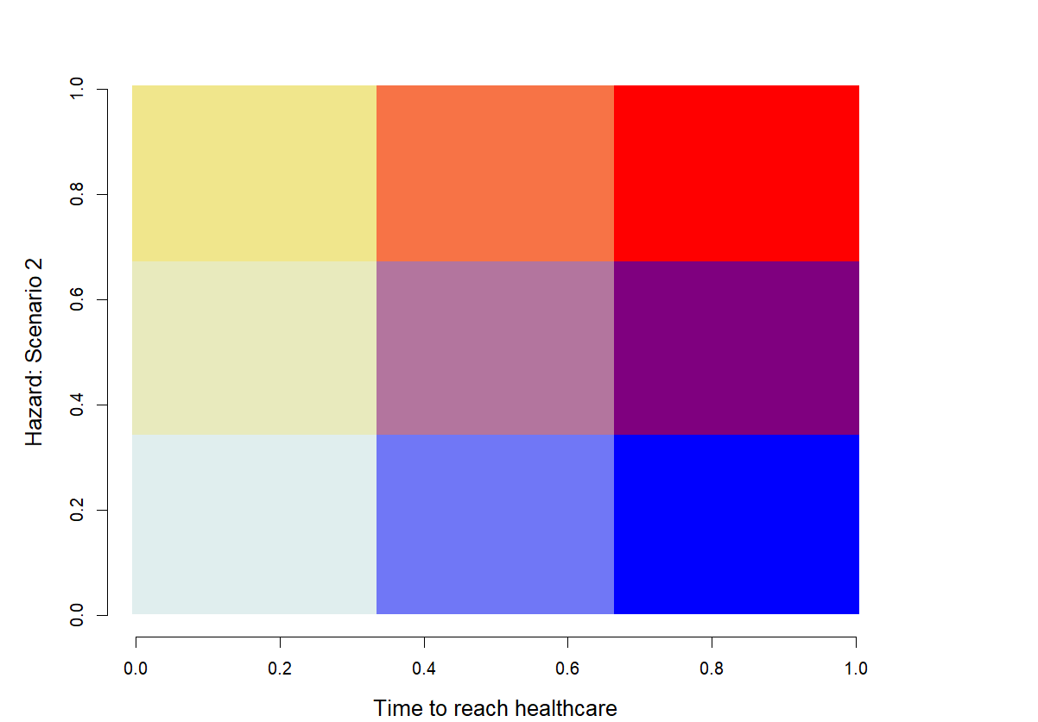
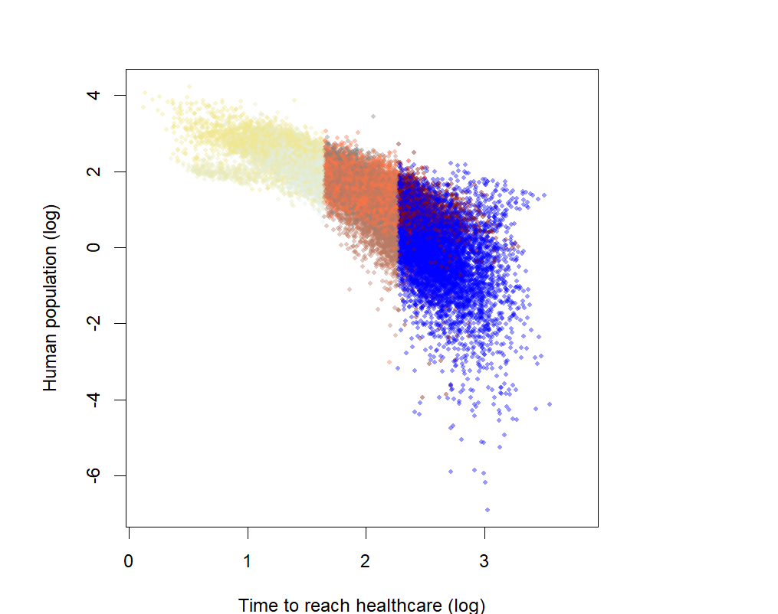

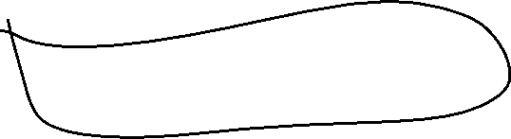

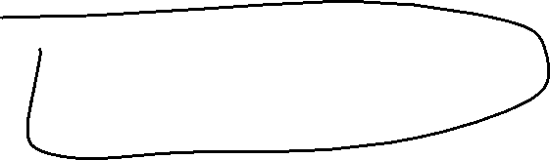

Spread
Spillover debt:
Urgent action
Moderate priority for discovery,
prioritise understanding known hosts
Prioritize
OneHealth,
Host discovery
and public health access
(surveillance, fixed and mobile clinics)
- Hazard: all scenarios
Host bias reduction from surveillance
Conditionally safer zones:
focus on other
risks reduction
Safer zones
- Time to reach healthcare +

Slide 9
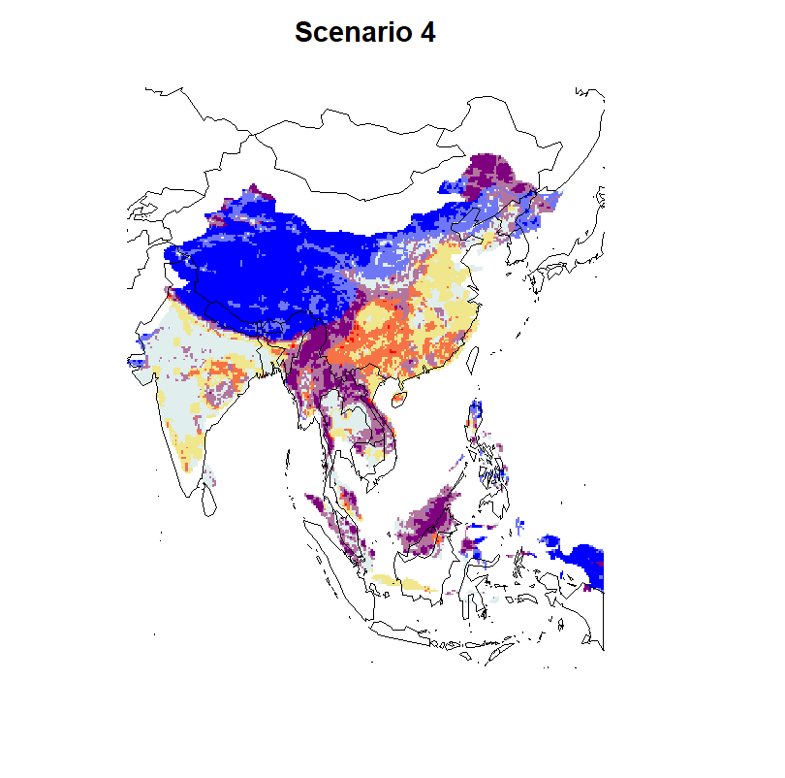

Slide 10
3
9
12
2
8
11
- Hazard: Scenario 1 +
1
7
10
- Time to reach healthcare +

Slide 11
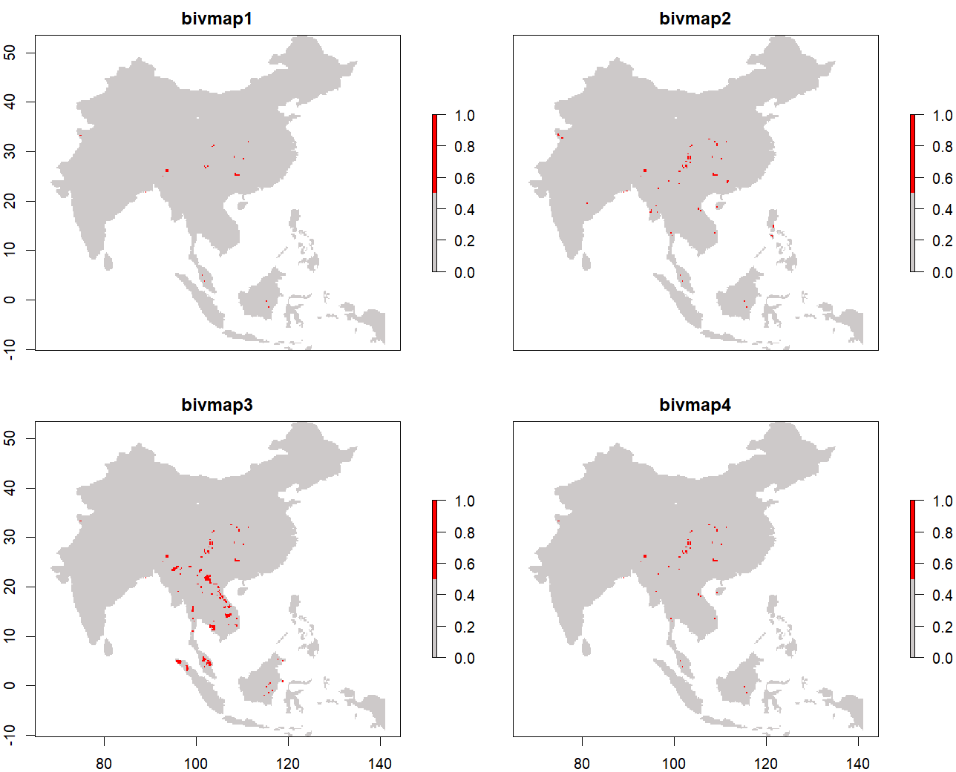
26 red areas
78 red areas
236 red areas
59 red areas

Slide 12
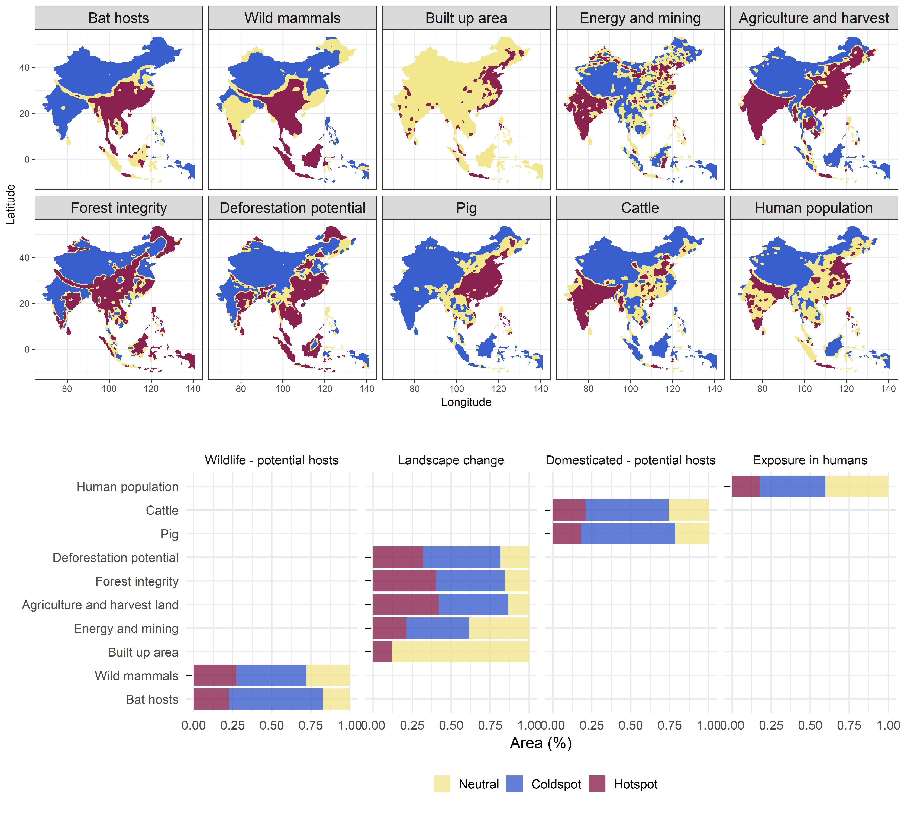
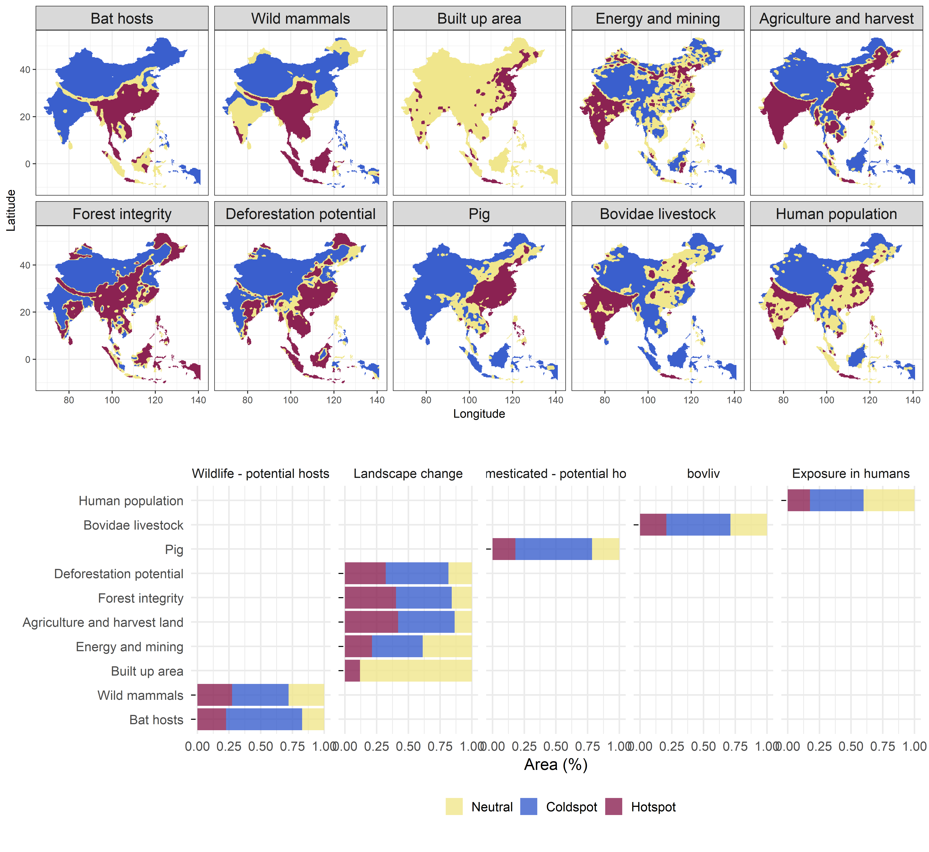


Changes on what is the mammal layer:
Previously: all mammals (deleted)
Now: all mammals minus bat hosts (mmb)
Inclusion of all bovidae livestock (buffalo+sheep+goat+cattle) in comparison with cattle: present cattle OR bovidae livestock in the main text and the other in the supplements.

Slide 13
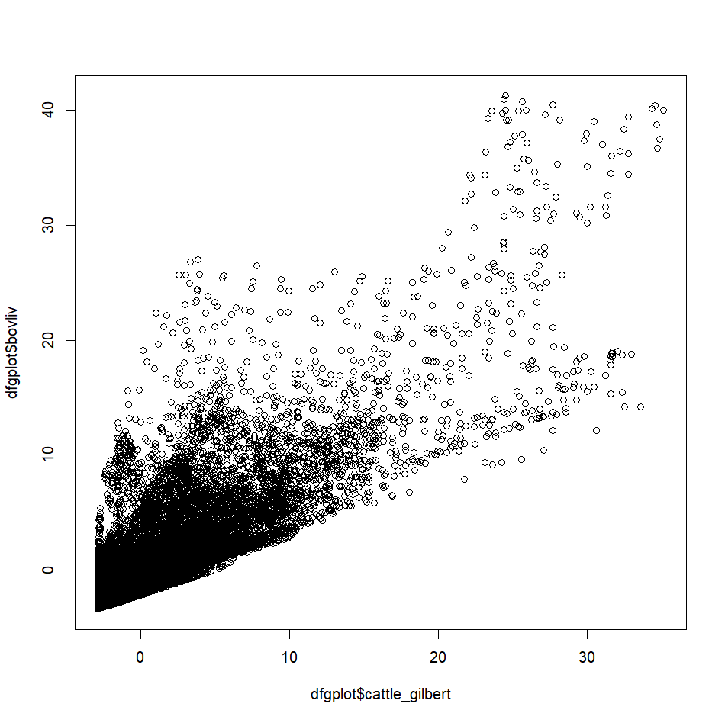
Summing buffalo+cattle+goats+sheep makes the hotspots less intense, by spatially evenning out their value. This may be even more realistic for hazard?
buffalo_cattle_goat_sheep
> max(p$cattle_gilbert)
[1] 68677.8
> max(p$buffalo_cattle_goat_sheep)
[1] 104970.1
cattle

Slide 14
Changes on what is the mammal layer:
Previously: all mammals (deleted)
Now: all mammals minus bat hosts (mmb)
Inclusion of all bovidae livestock (buffalo+sheep+goat+cattle) in comparison with cattle: present cattle OR bovidae livestock in the main text and the other in the supplements.
Changes in scenario 2: tests with 4 scenarios
Scenario 2 cattle: Bat Hosts + mammals mmb + pig + cattle + everything else
Scenario 2 all bovidae: Bat Hosts + mammals mmb + pig + bovidae livestock + everything else
Reason to stay: nested with scenario 1. ‘It is the reality’, as every layer is out there
Reason to delete: it pushes away from checking differences with scenario one.
Scenario 2 no bat hosts cattle: mammals mmb + pig + cattle + everything else
Scenario 2 no bat hosts all bovidae: mammals mmb + pig + bovidae livestock + everything else
Reason to stay: Because it is not nested with scenario 1, we can see differences better (‘bat host’ excess can be approximated to bigger risks, or a model focused on SARS-like covs in scenario 1, while scenario 2 is general risk of zoonotic infectious diseases)
Reason to delete: -

Slide 15
1) landuse+ & people & bats; [direct transmission]
2) landuse+ & people & bats; + livestock [livestock intermediate host]
3) landuse+ & people & bats; + wild mammals [wild mammal intermediate hosts]
4) landuse+ & people & bats; + livestock + wild mammals [wild mammal & livestock intermediate hosts]

Slide 16


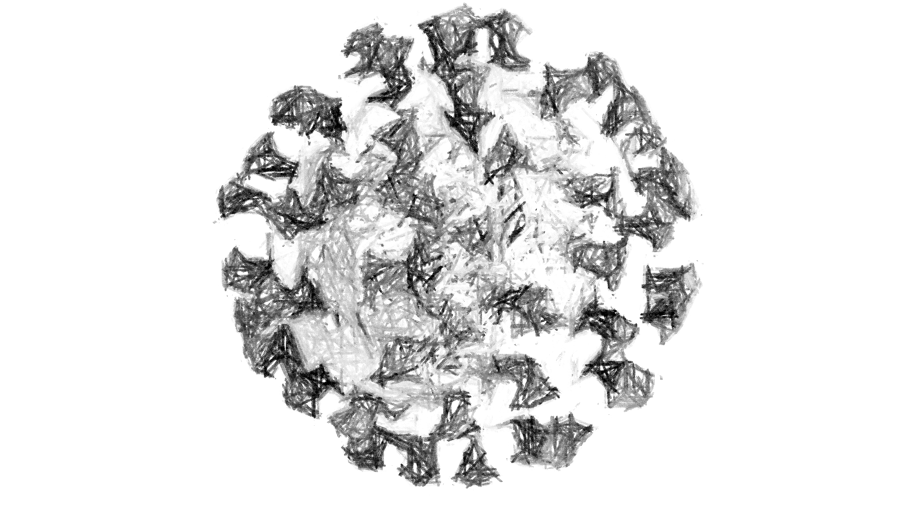
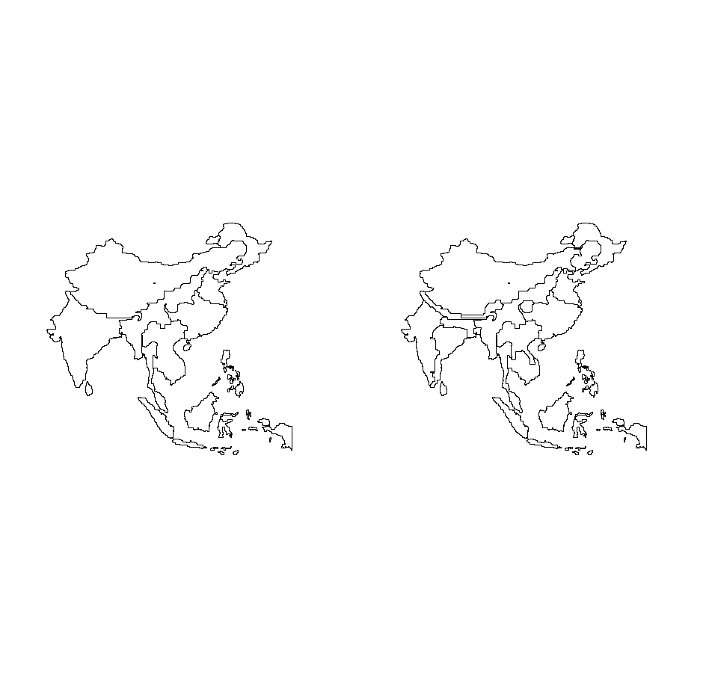
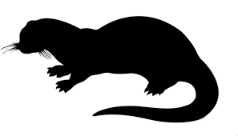
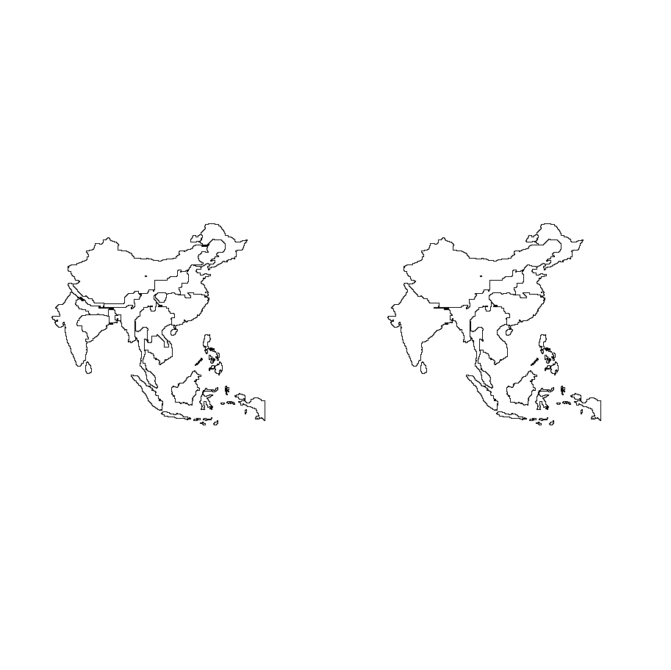
9 clusters
cattle
19 clusters
19 clusters
9 clusters
all bovidae livestock

Slide 17
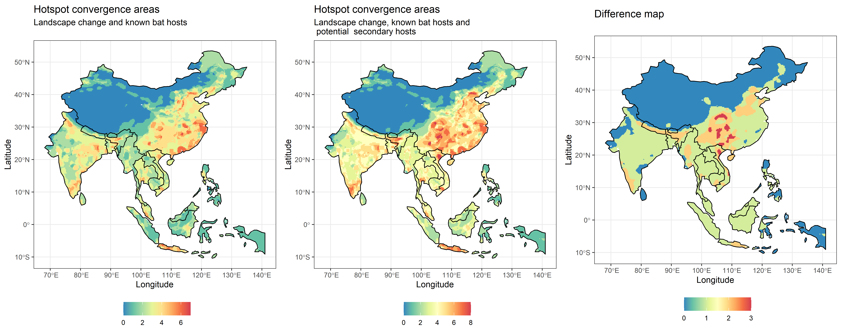
Bat Hosts + mammals mmb + pig + cattle + everything else
table(db$n_hotspots_risk2 - db$n_hotspots_risk1)
0 1 2 3
12093 10569 2816 318

Slide 18
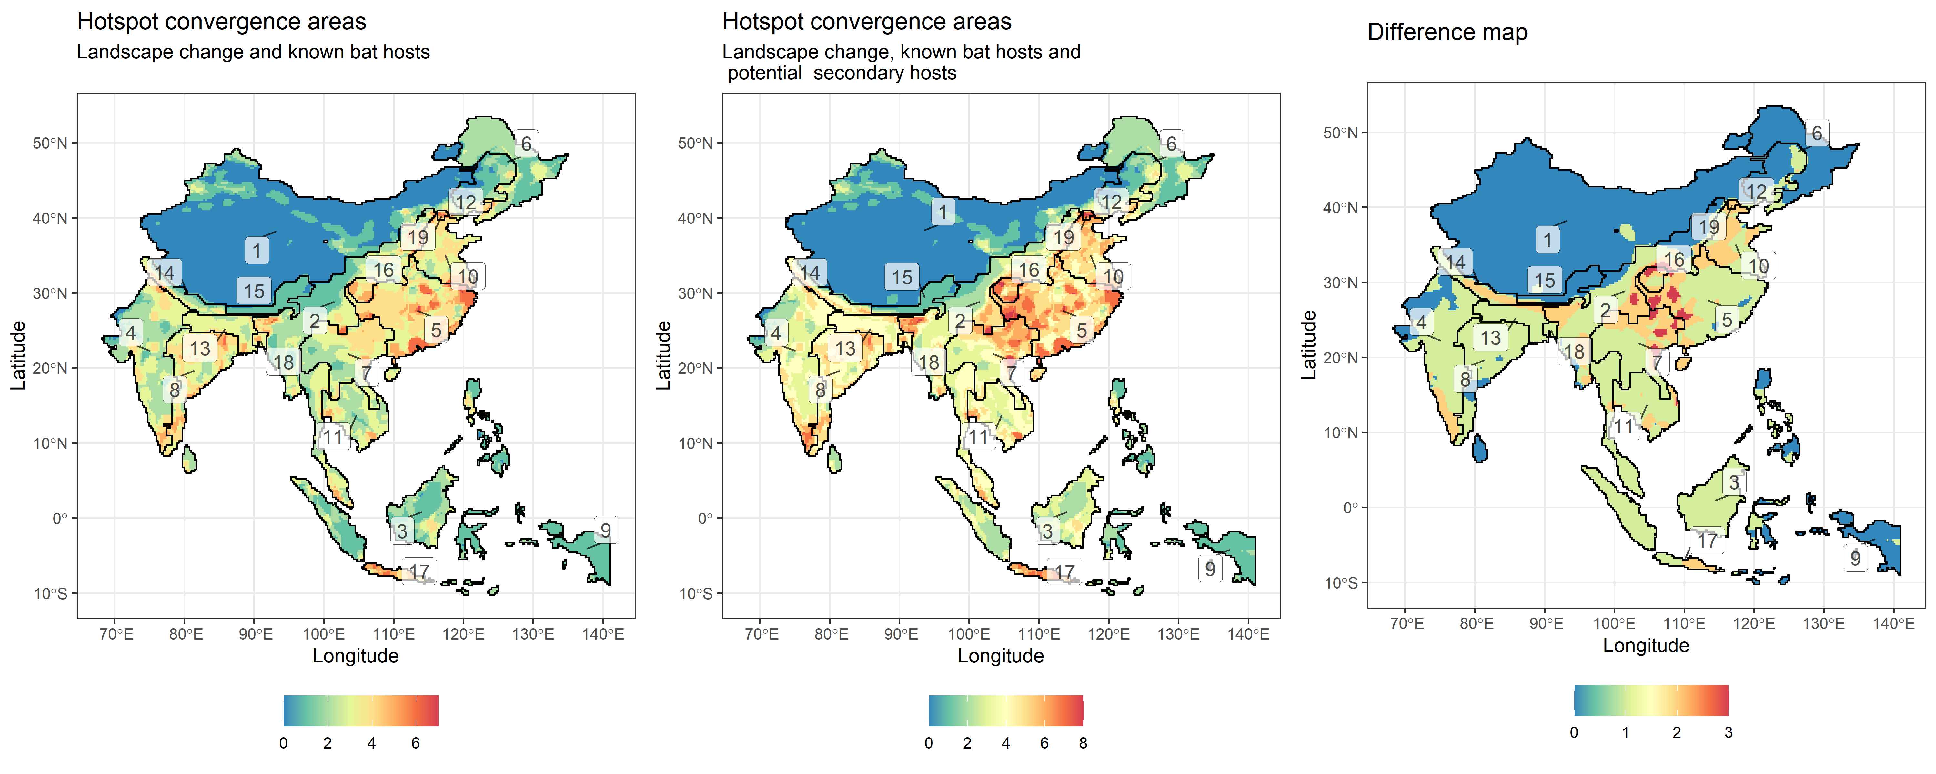
Bat Hosts + mammals mmb + pig + cattle + everything else

Slide 19
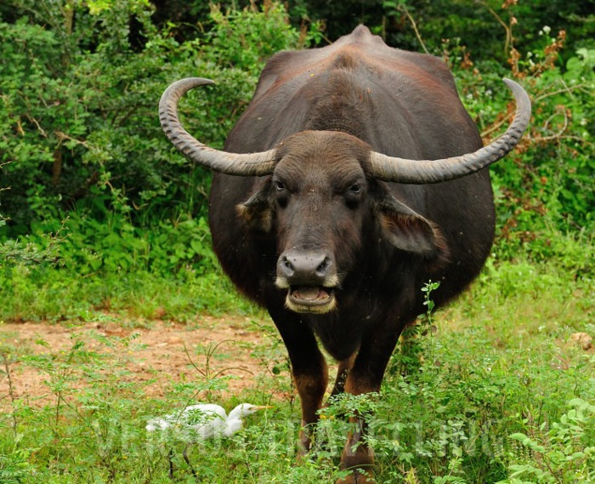
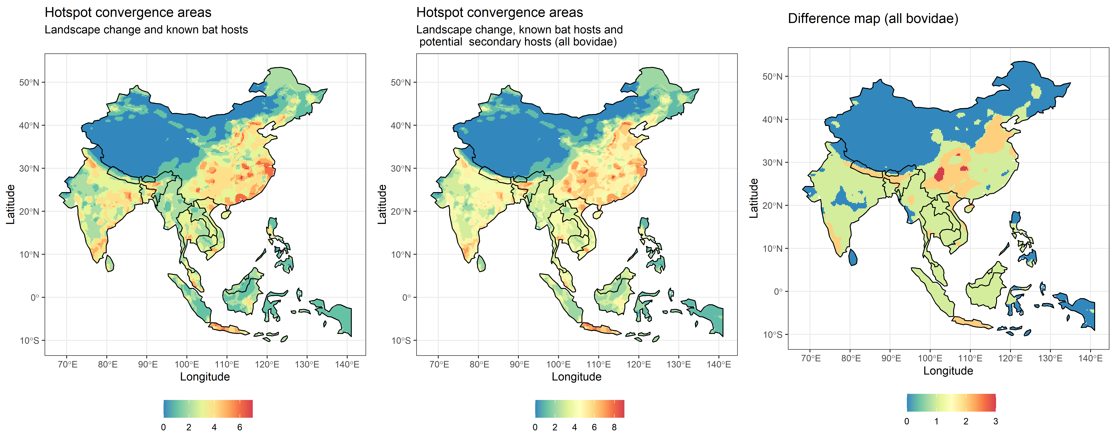
Bat Hosts + mammals mmb + pig + bovidae livestock + everything else

Slide 20
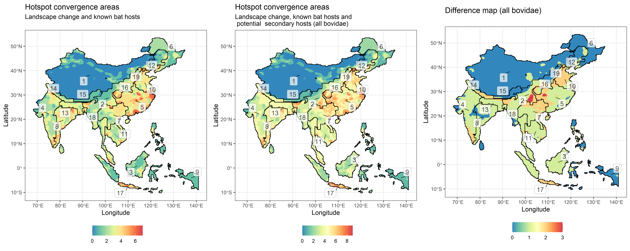
Bat Hosts + mammals mmb + pig + bovidae livestock + everything else

Slide 21
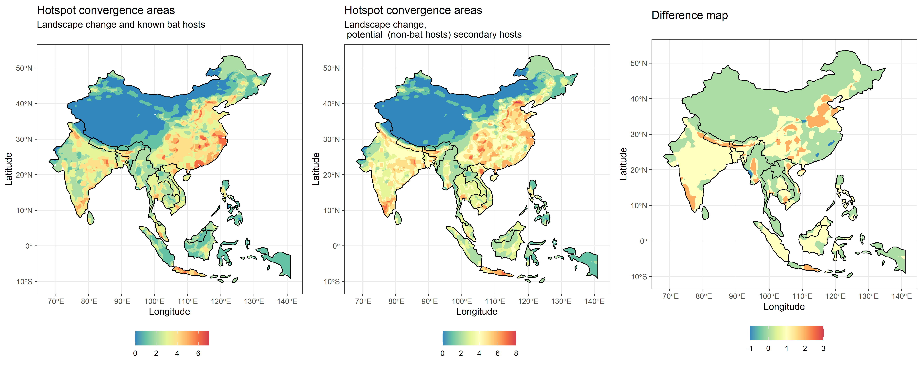
mammals mmb + pig + cattle + everything else
dif
-1 0 1 2 3
74 15908 8229 1580 5

Slide 22
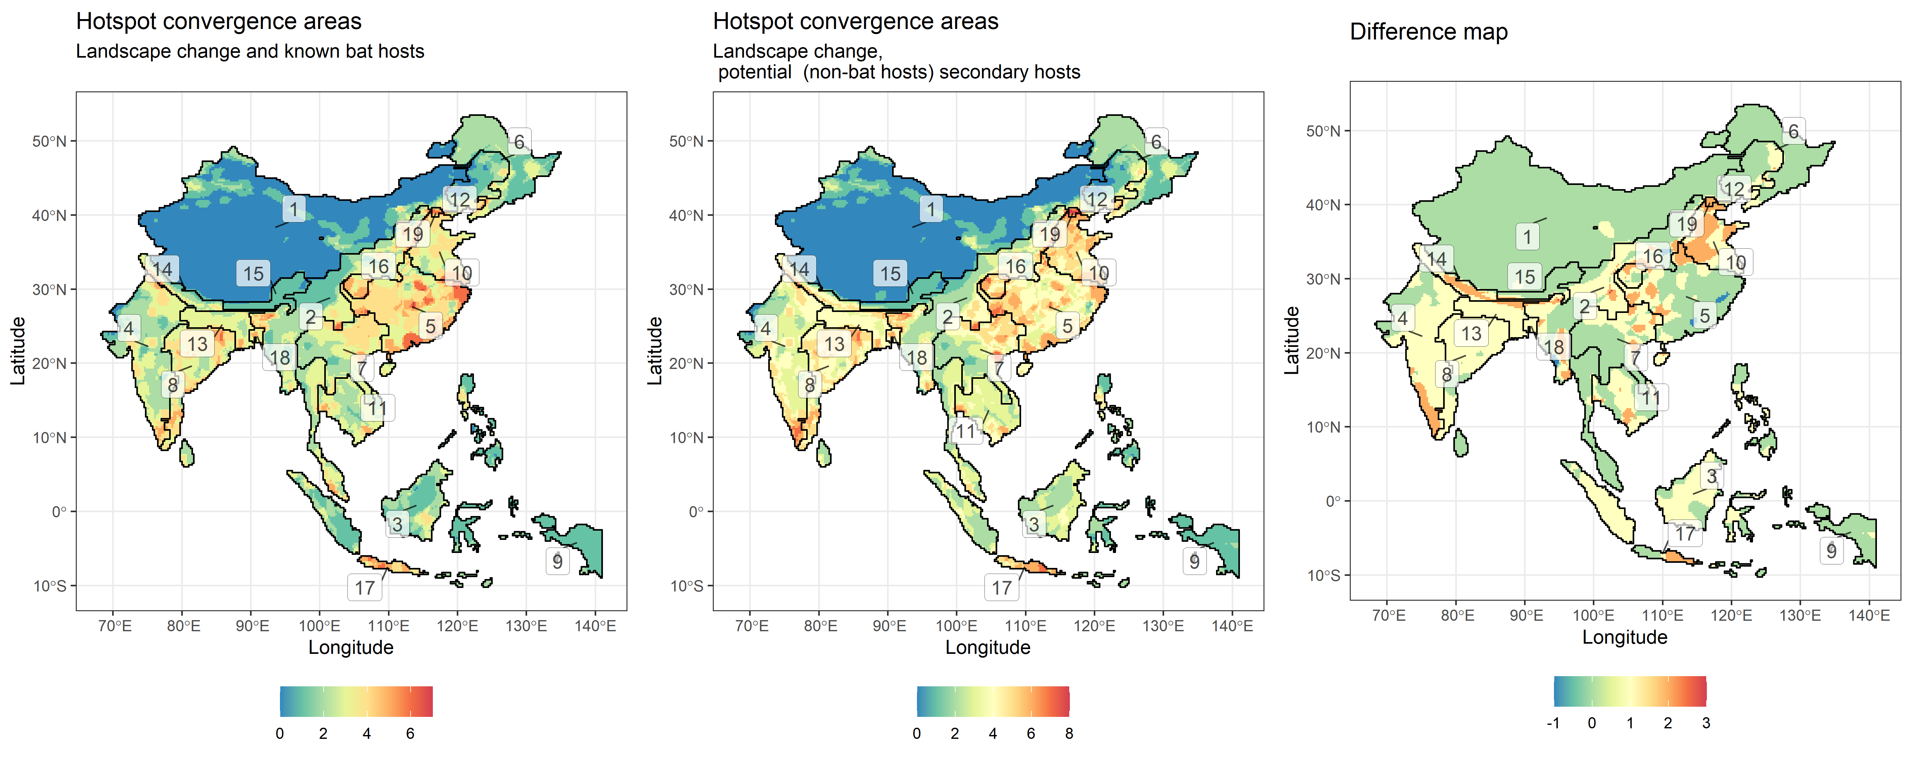
mammals mmb + pig + cattle + everything else

Slide 23
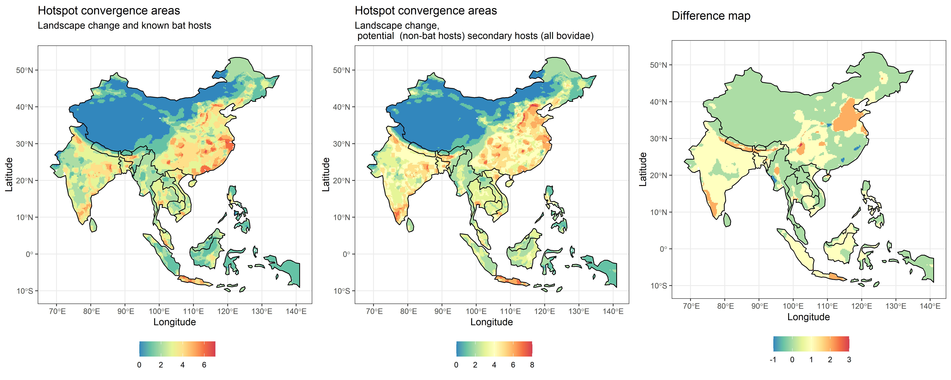
mammals mmb + pig + bovidae livestock + everything else

Slide 24
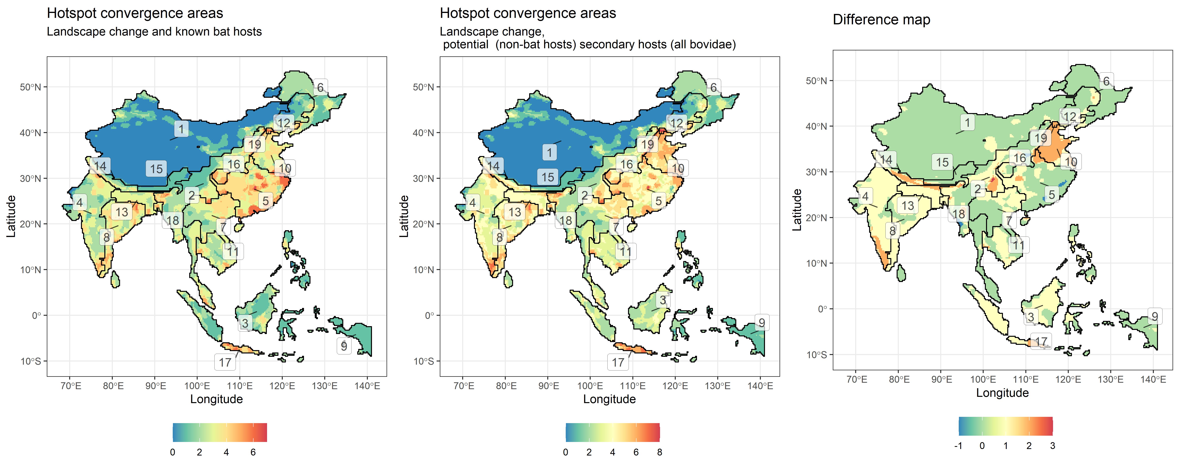
mammals mmb + pig + bovidae livestock + everything else

Slide 25
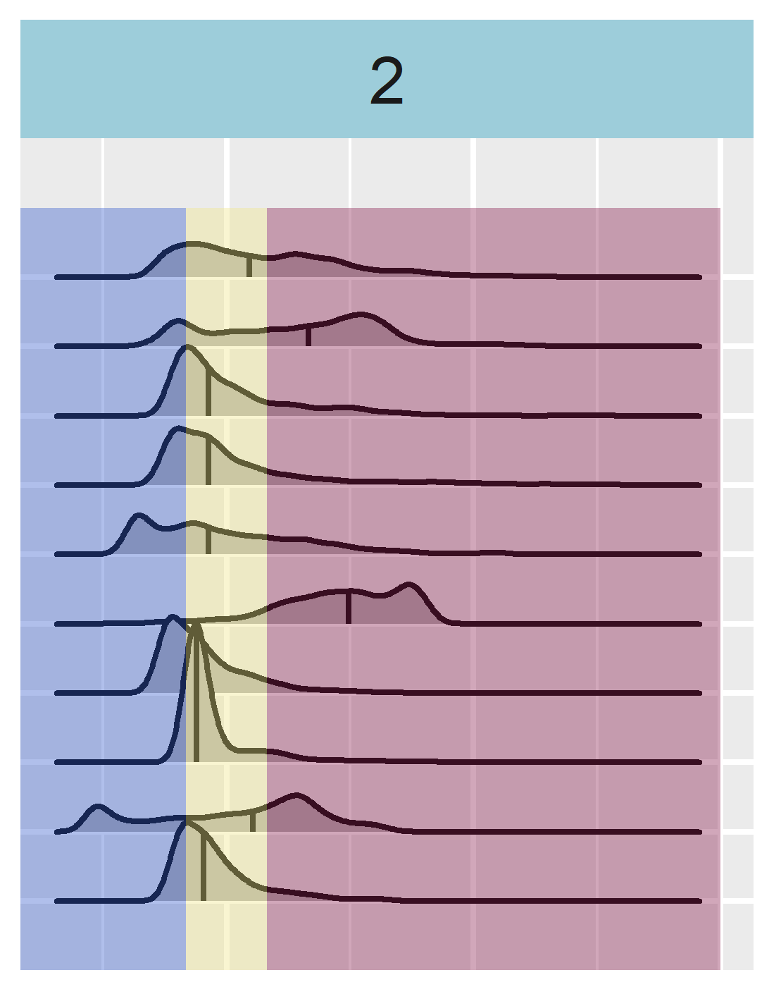
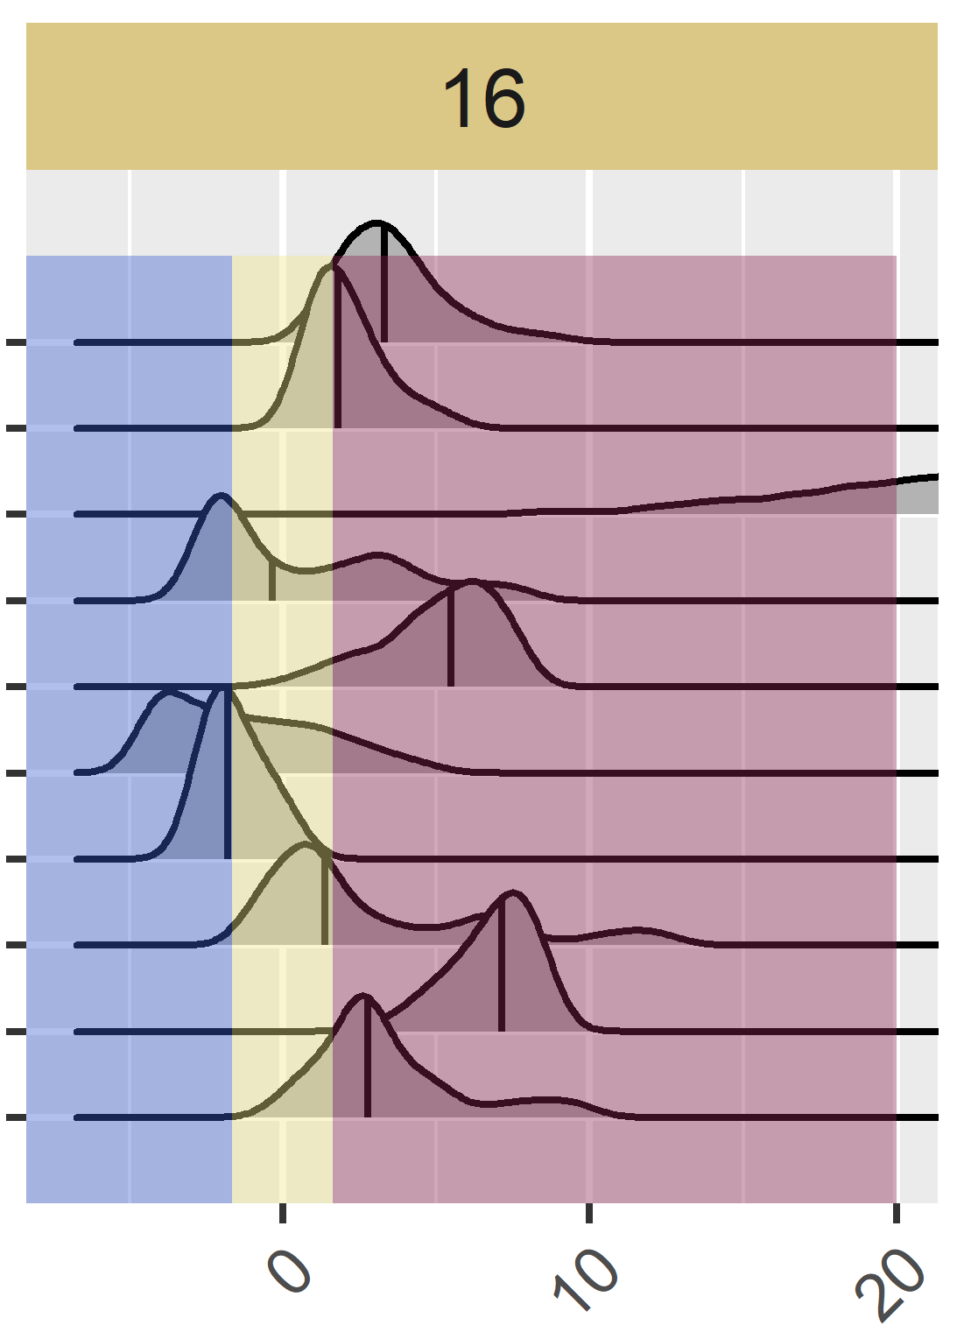
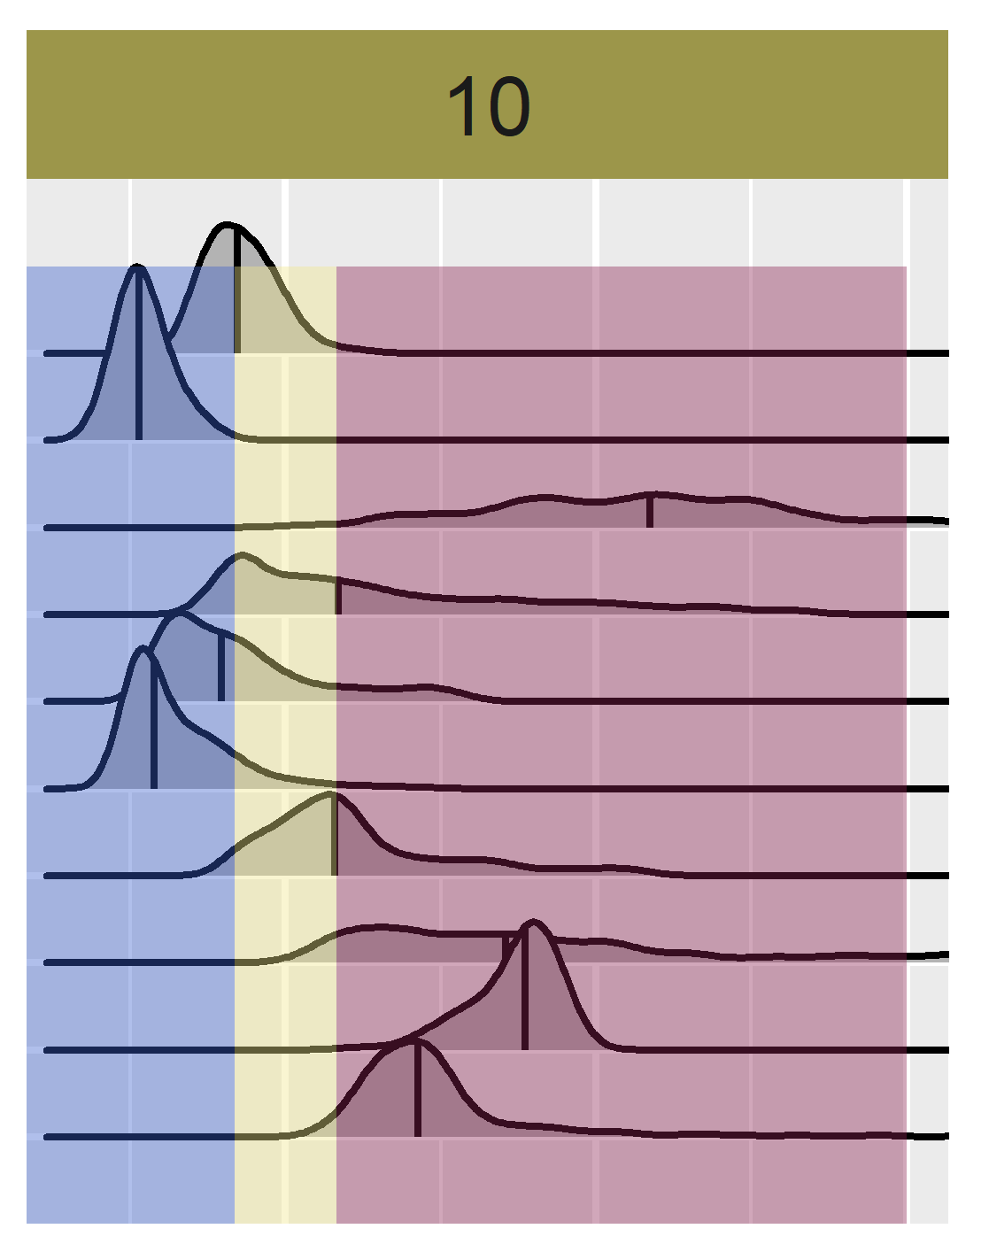
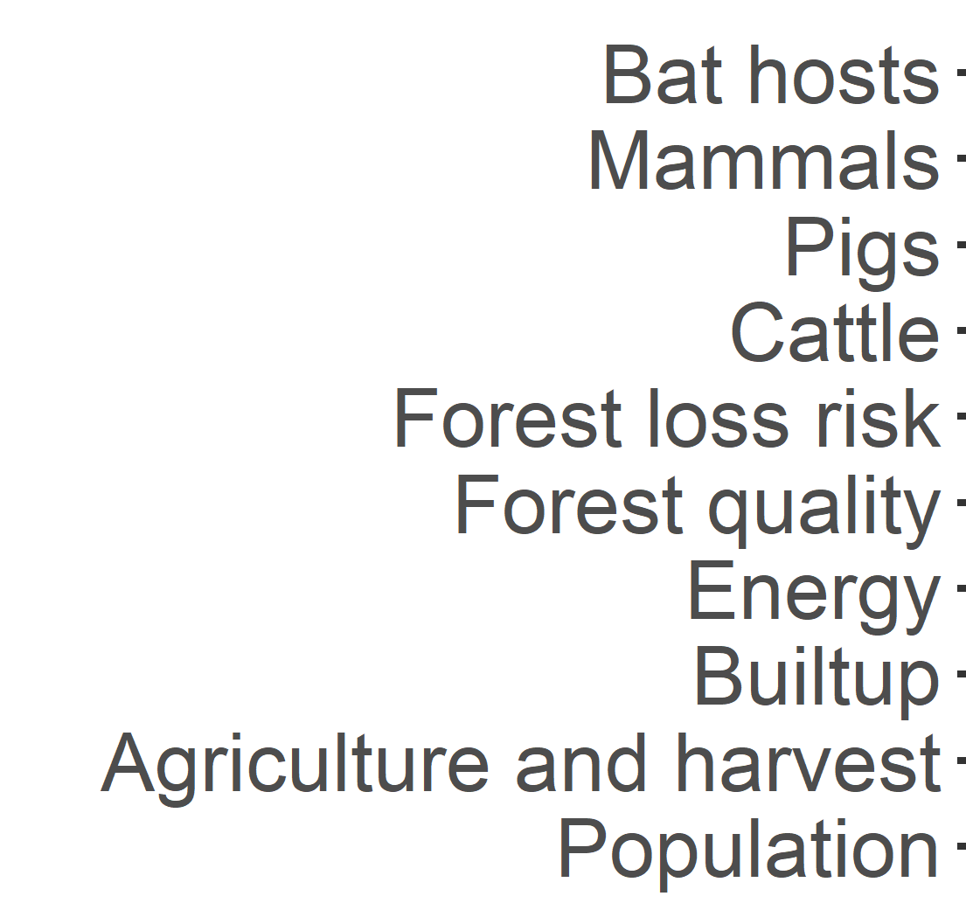

Slide 26
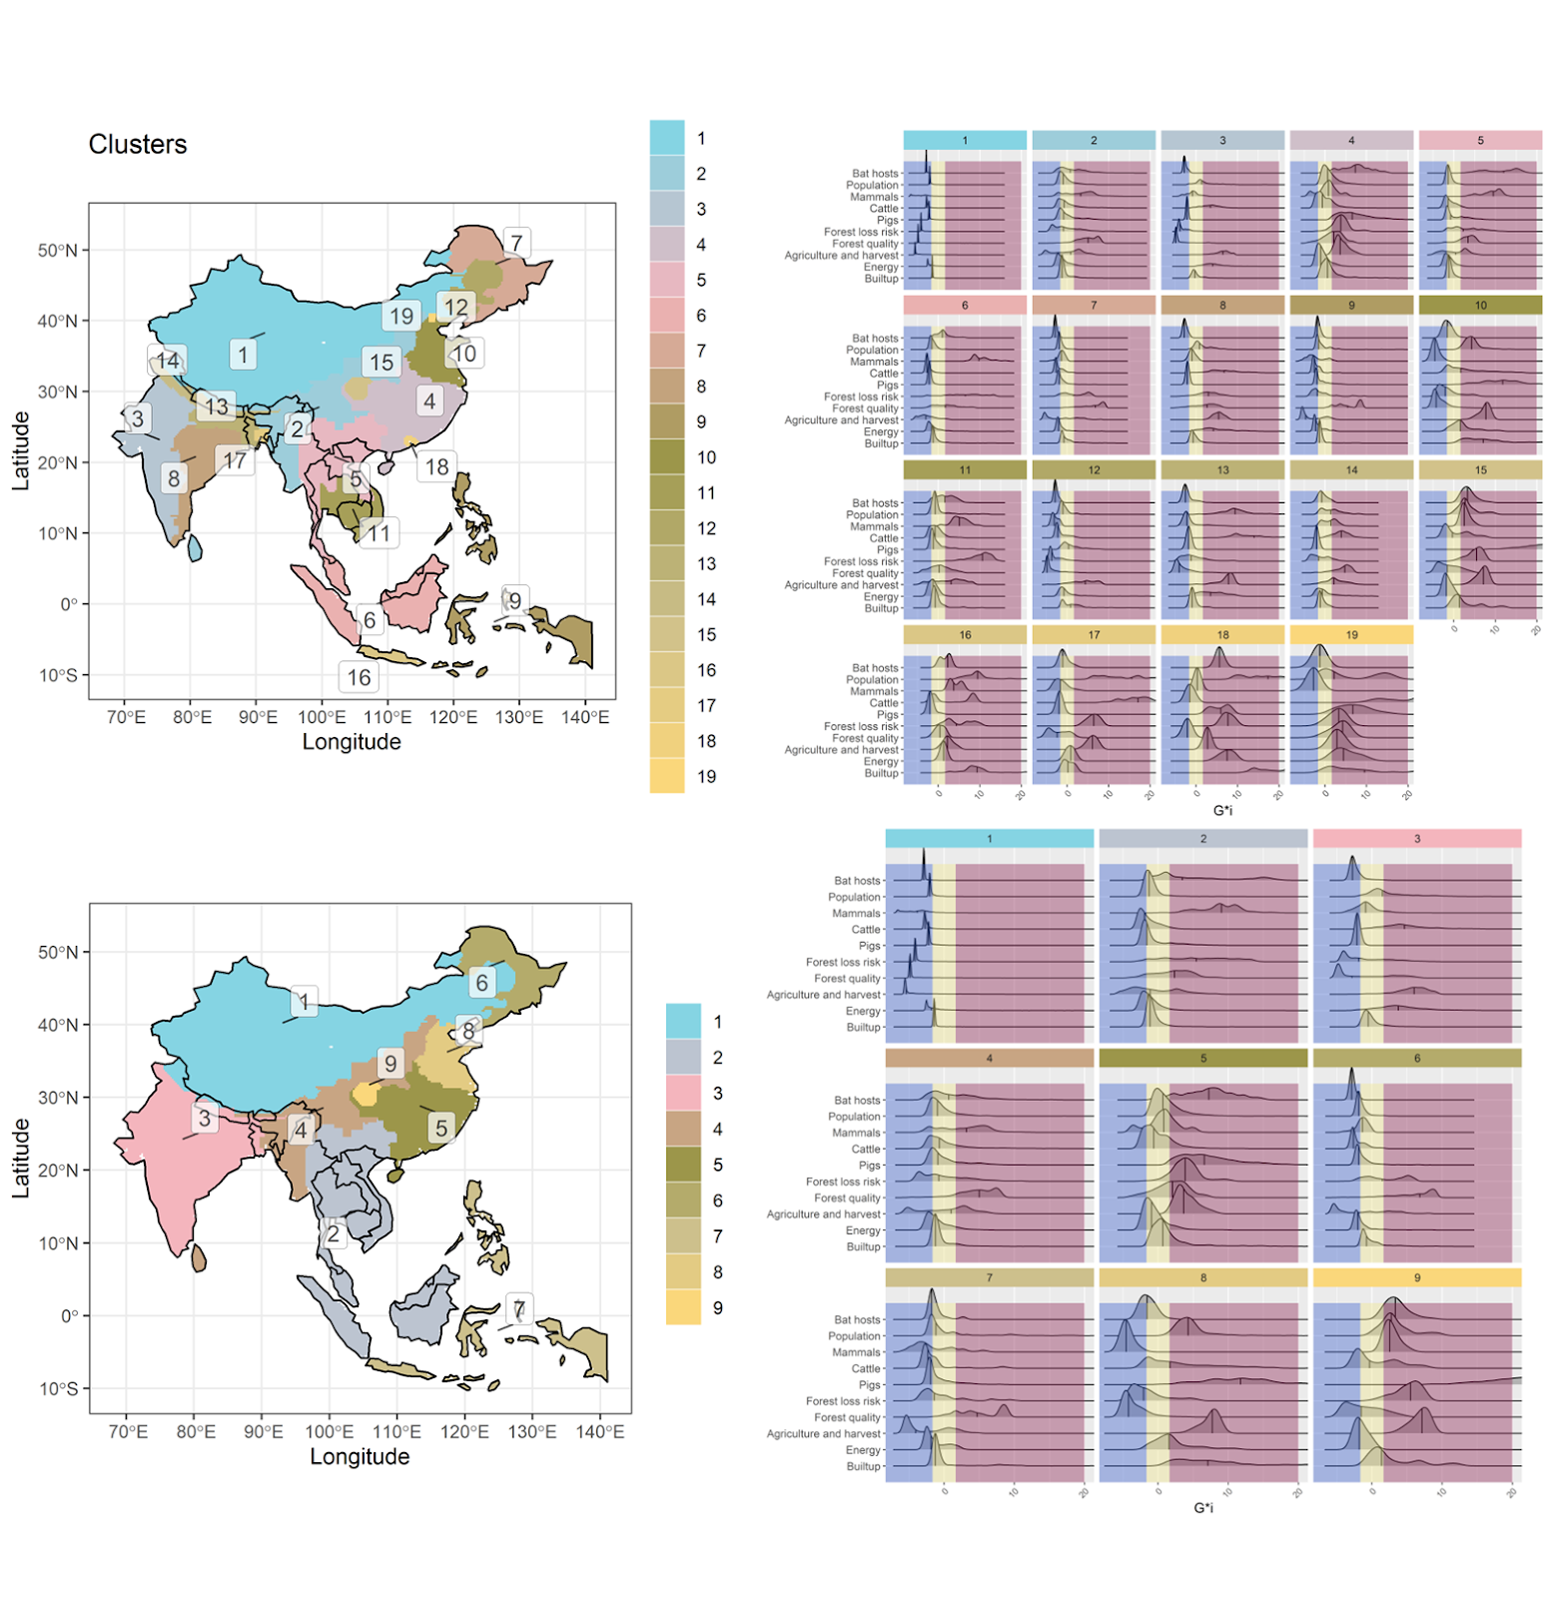
old

Slide 27
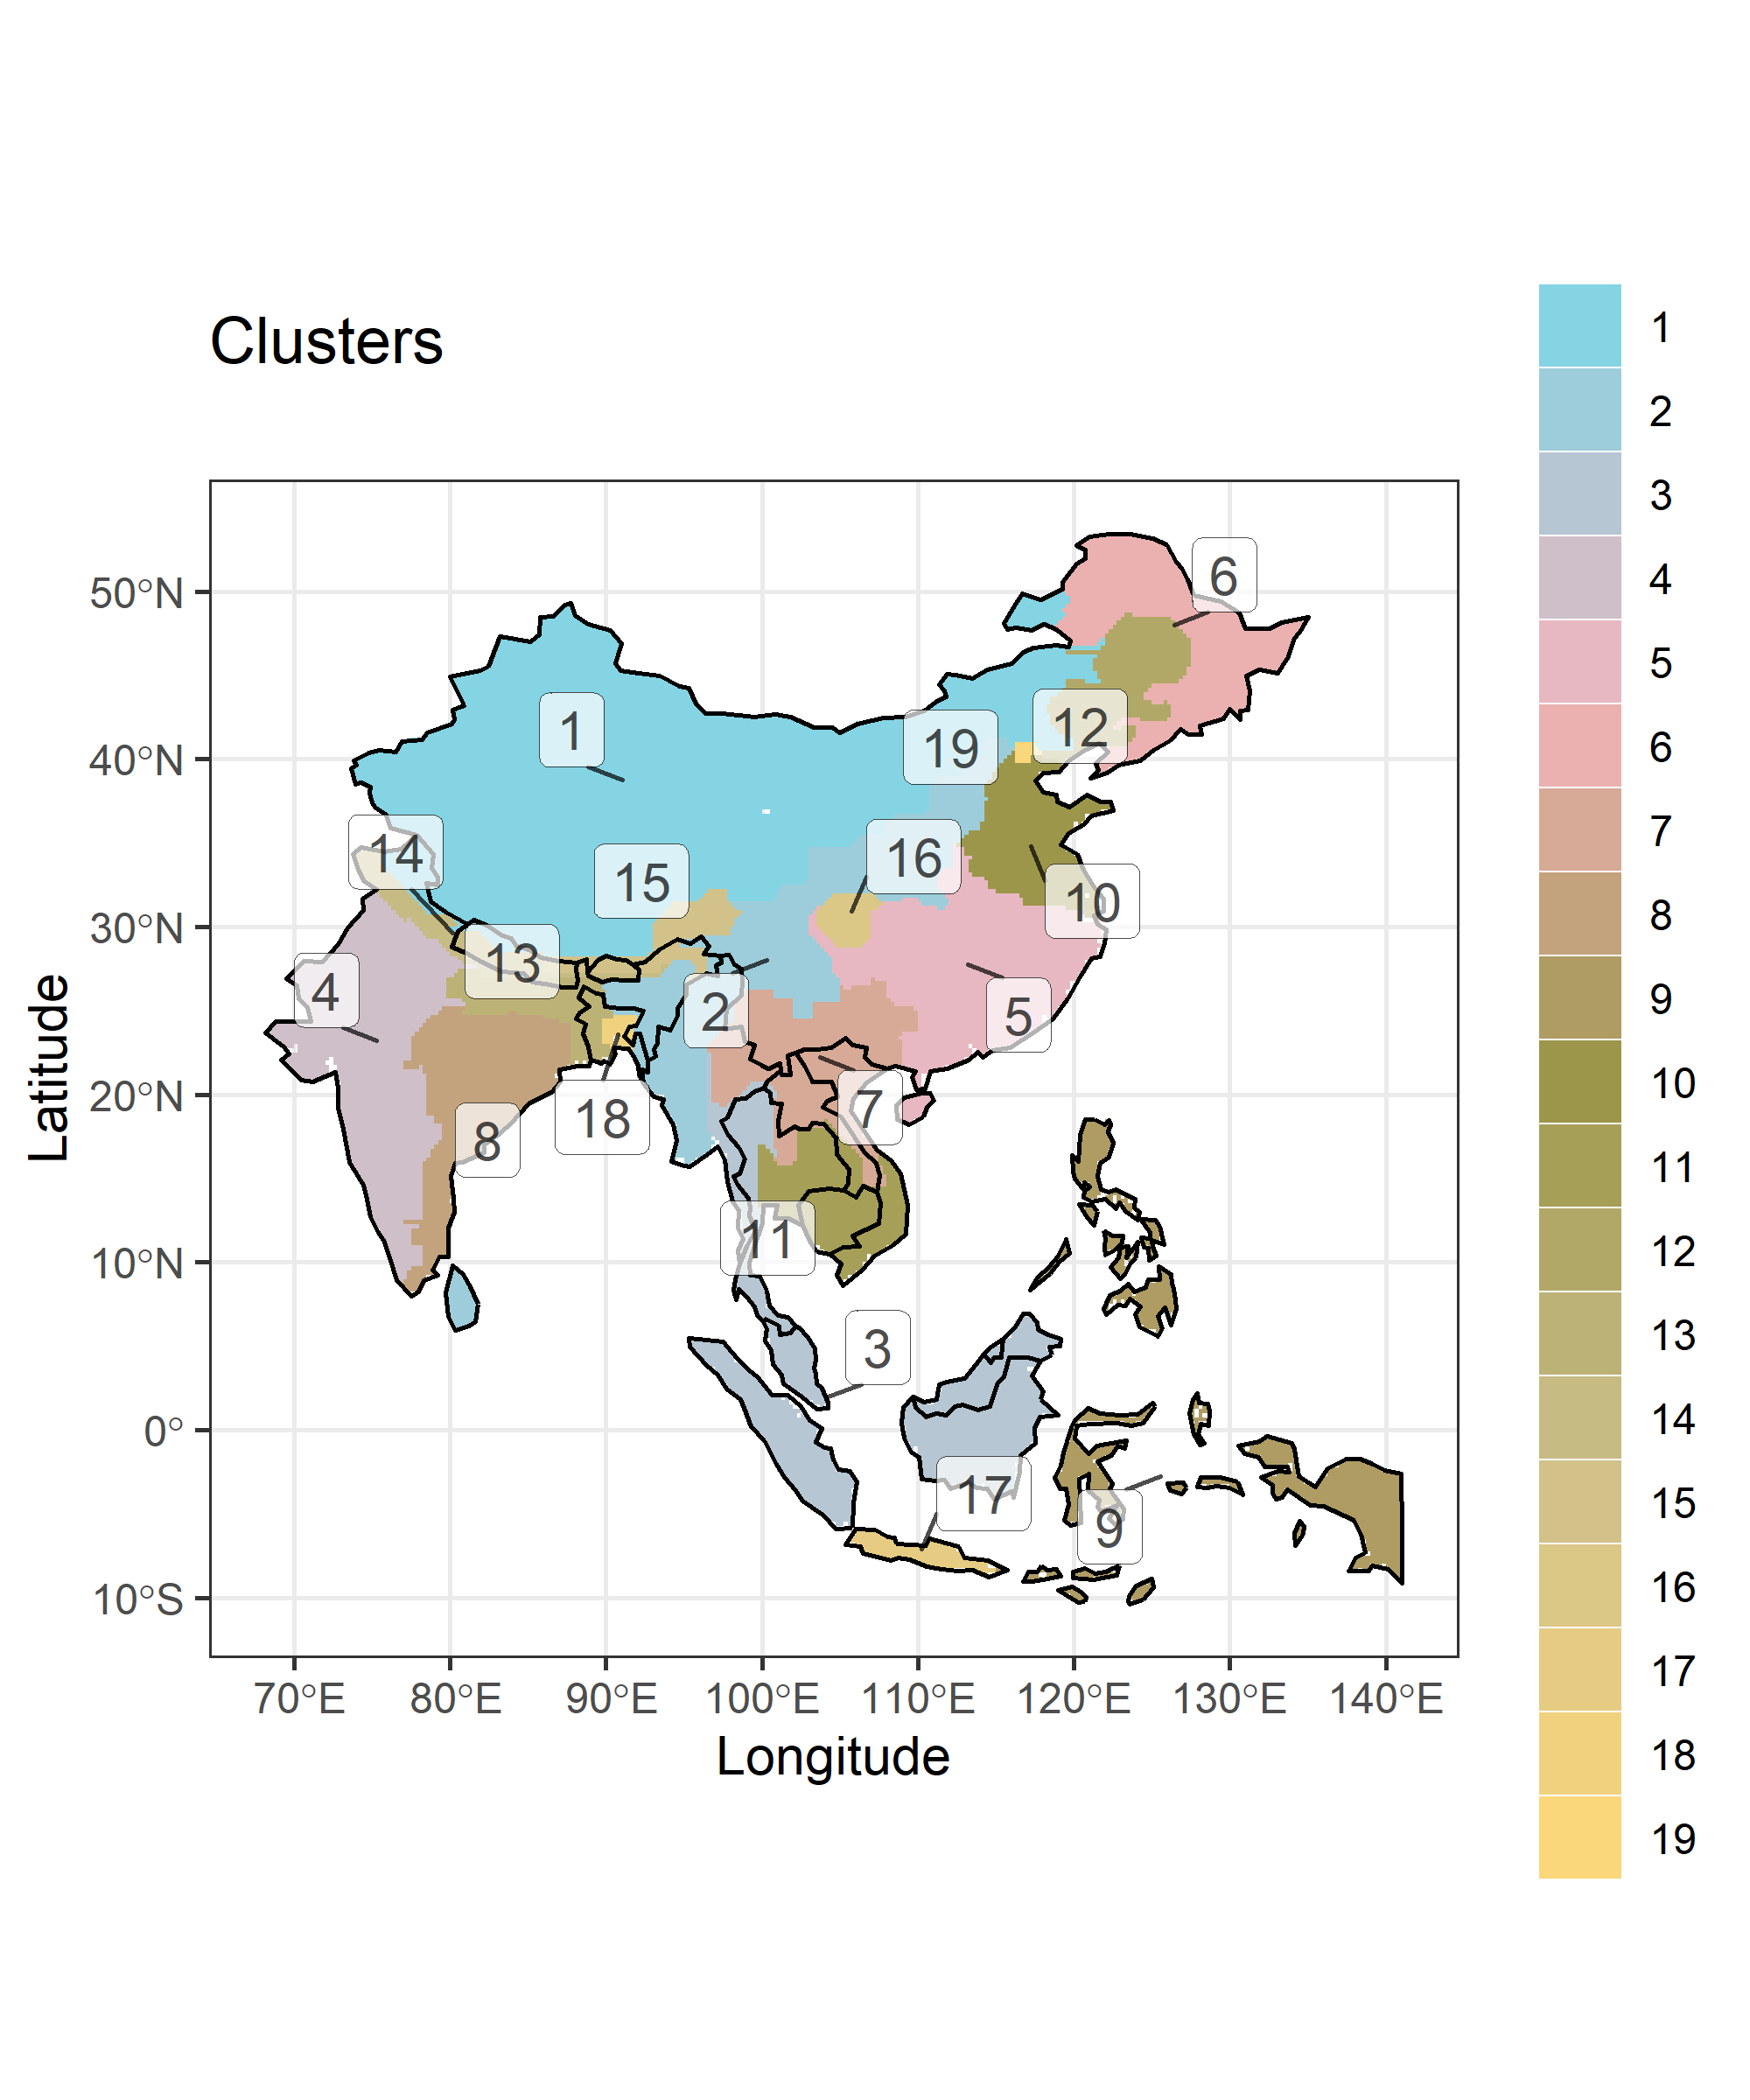

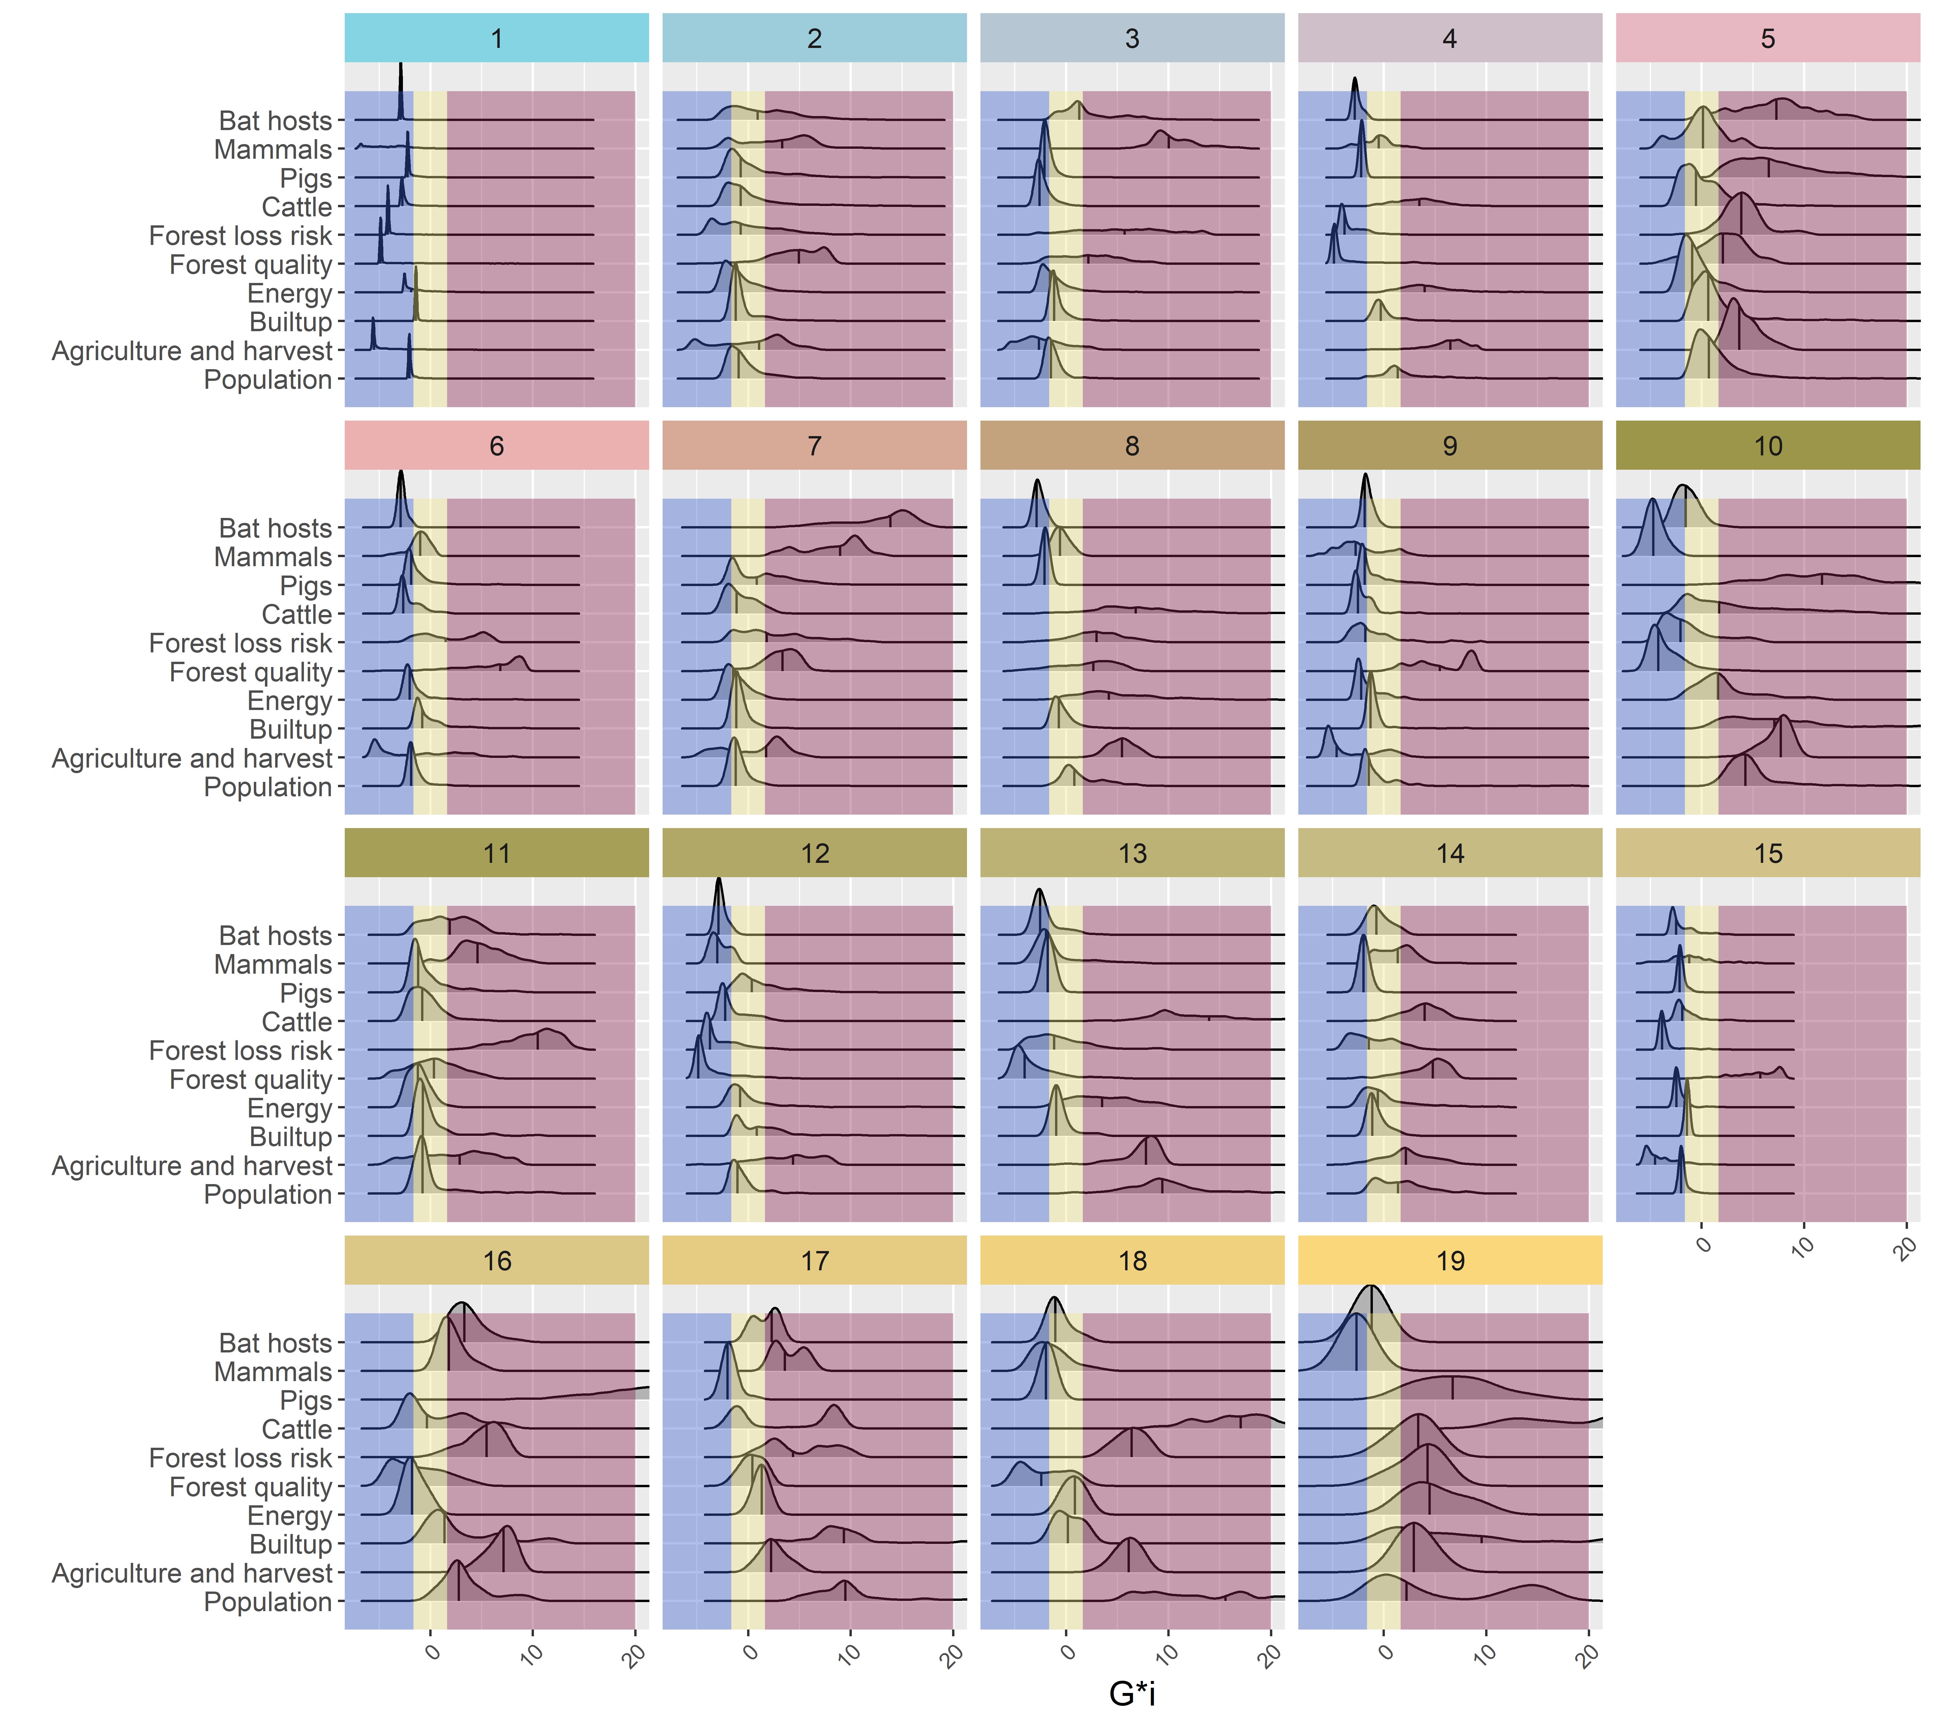
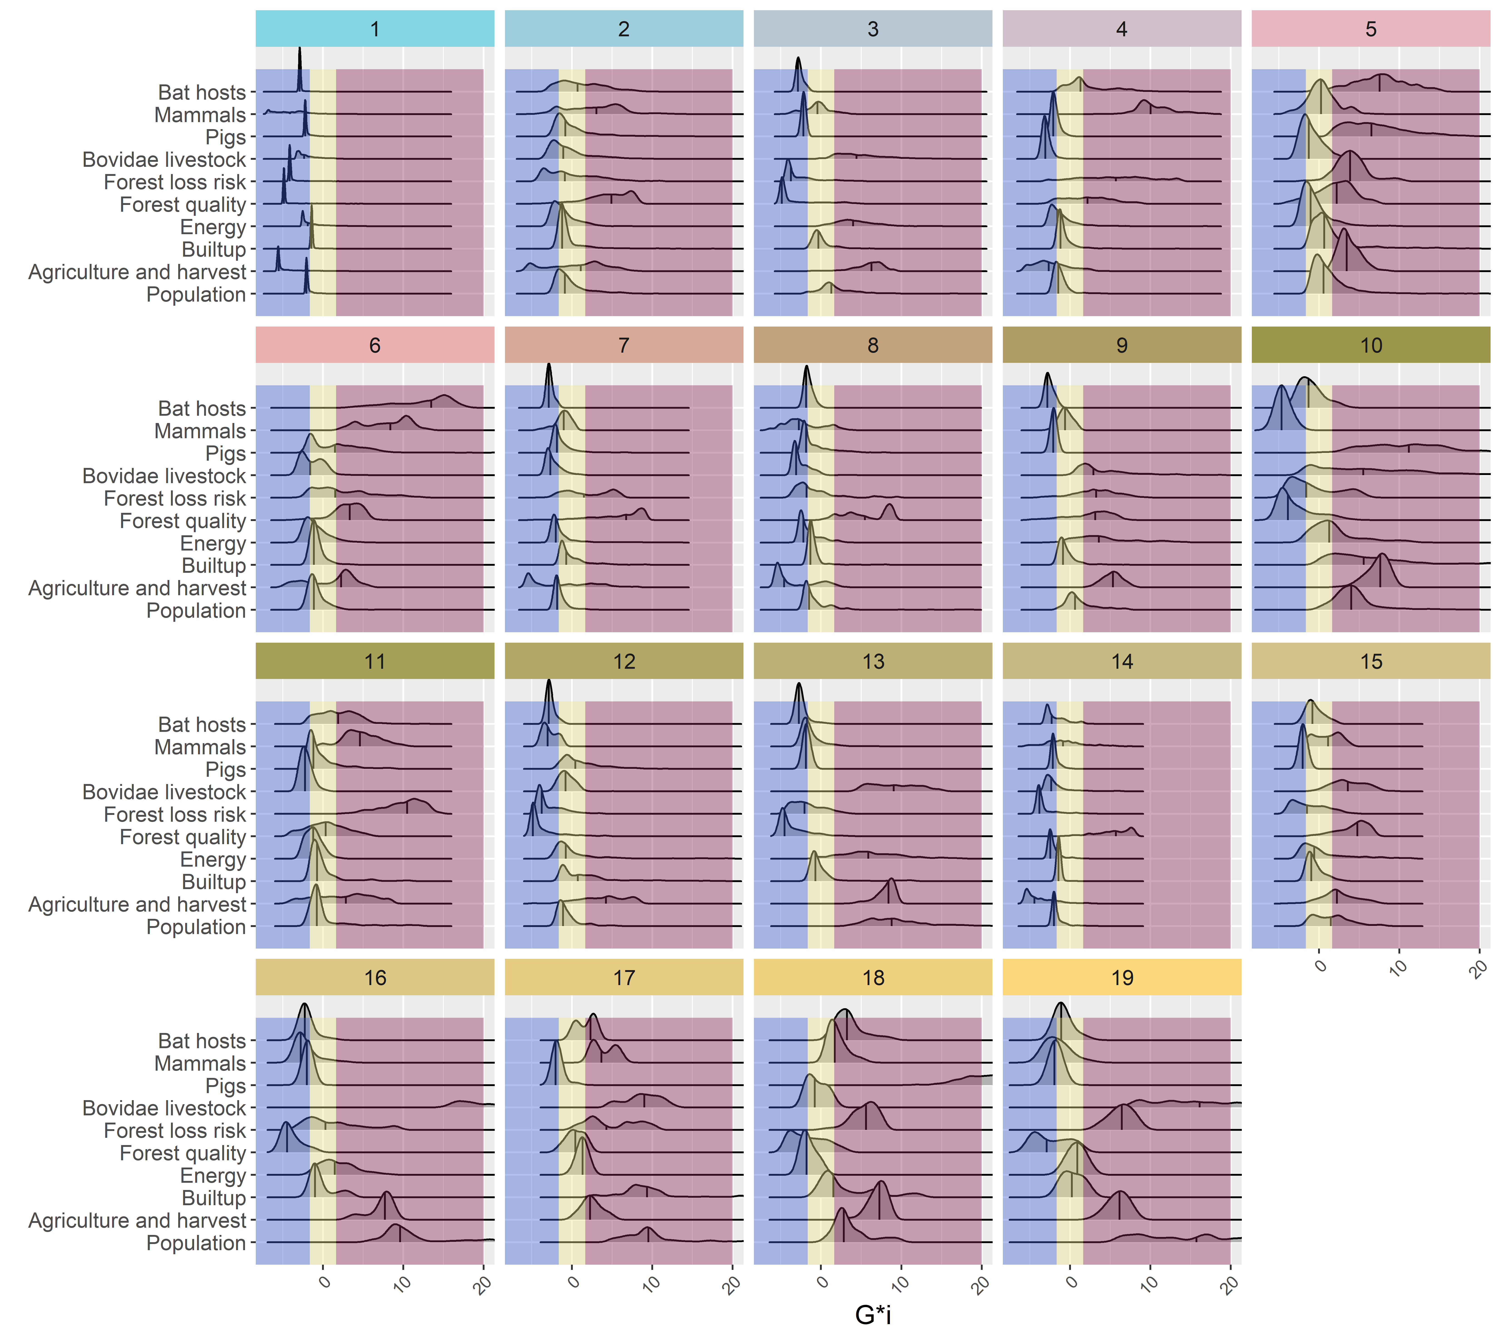

Slide 28
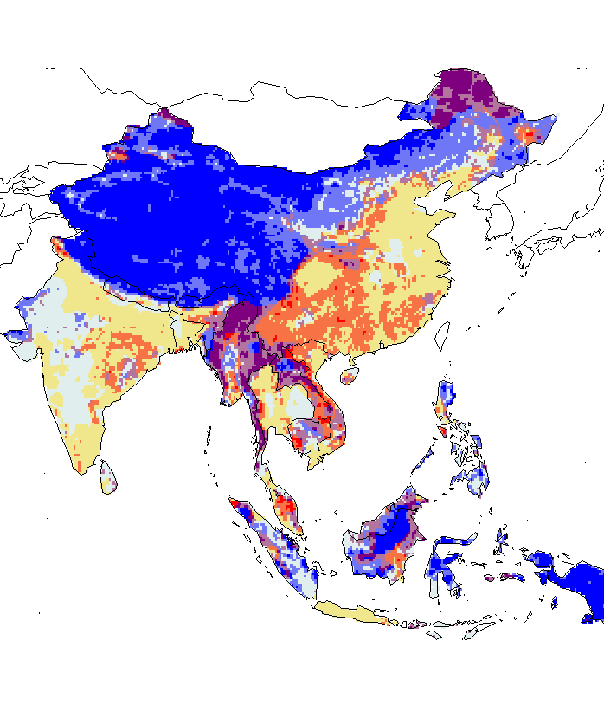

Bat Hosts + mammals mmb + pig + cattle + everything else
- Hazard: Scenario 1 +
- Hazard: Scenario 2 +
- Time to reach healthcare +
- Time to reach healthcare +

Slide 29
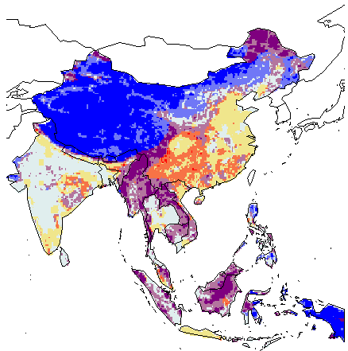
Bat Hosts + mammals mmb + pig + bovidae livestock + everything else
- Hazard: Scenario 1 +
- Hazard: Scenario 2 (all bovidae) +
- Time to reach healthcare +
- Time to reach healthcare +

Slide 30
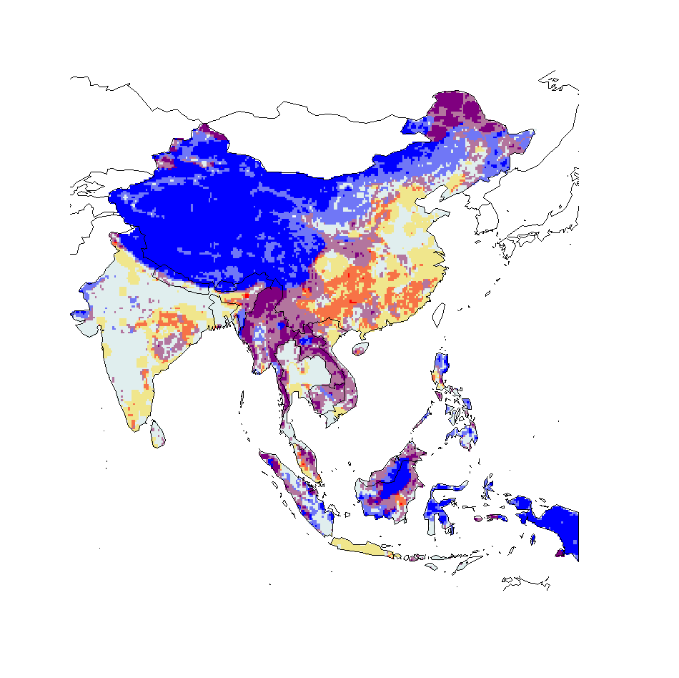
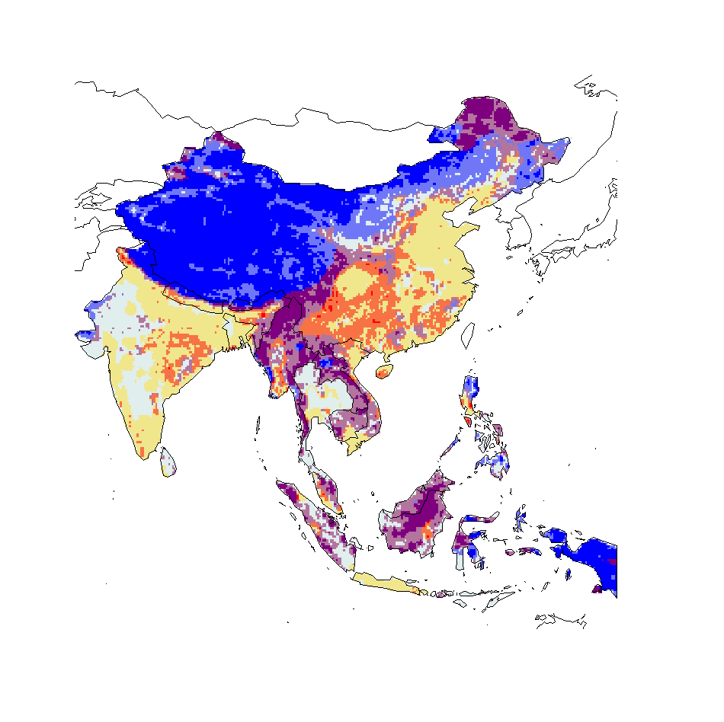
mammals mmb + pig + cattle + everything else
- Hazard: Scenario 1 +
- Hazard: Scenario 2 (mius bat hosts) +
- Time to reach healthcare +
- Time to reach healthcare +

Slide 31

Bovliv mammals minus bat
mammals mmb + pig + bovidae livestock + everything else
- Hazard: Scenario 1 +
- Hazard: Scenario 2 (all bovidae) +
- Time to reach healthcare +
- Time to reach healthcare +

Slide 32
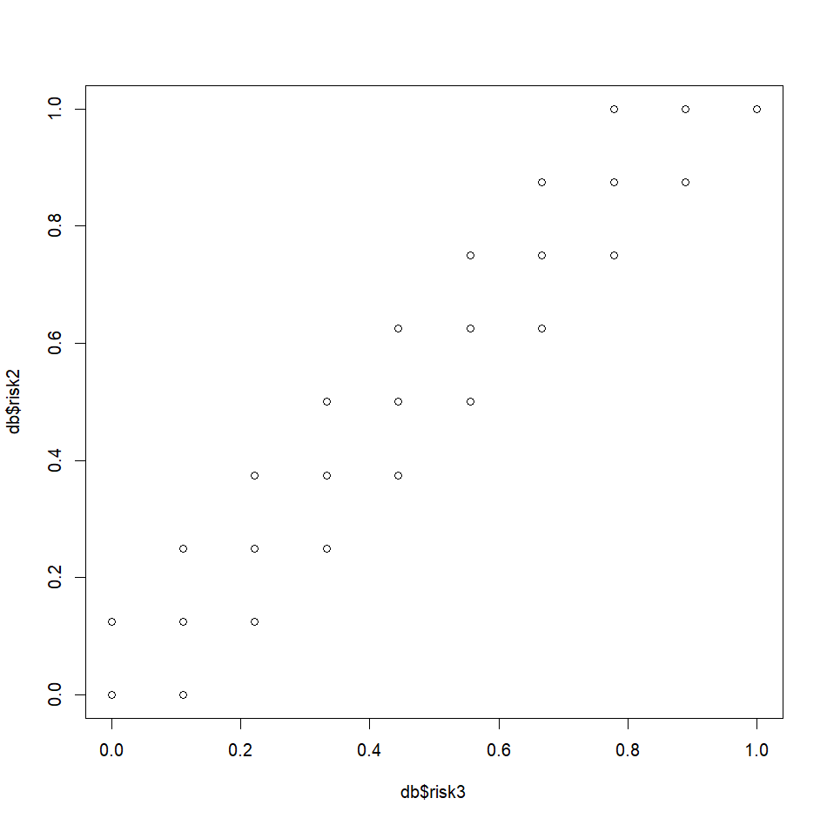
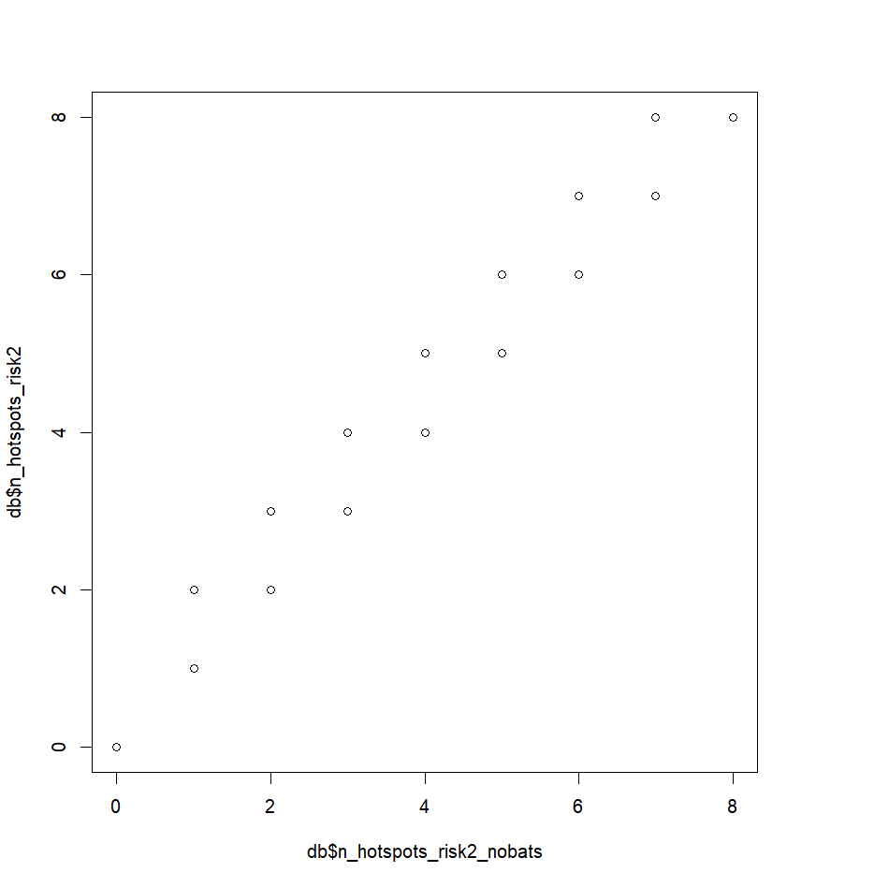
Differences are small
Risk 2 – just cattle
Risk 3 – all bovidae

Slide 33
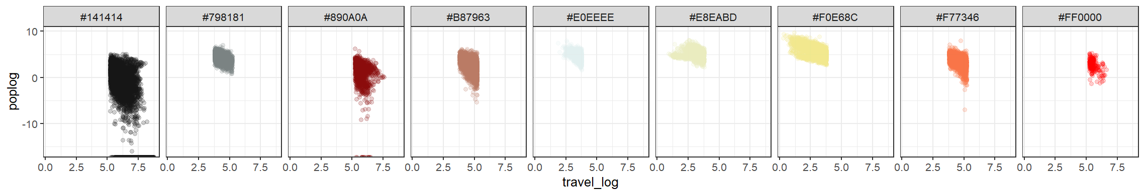
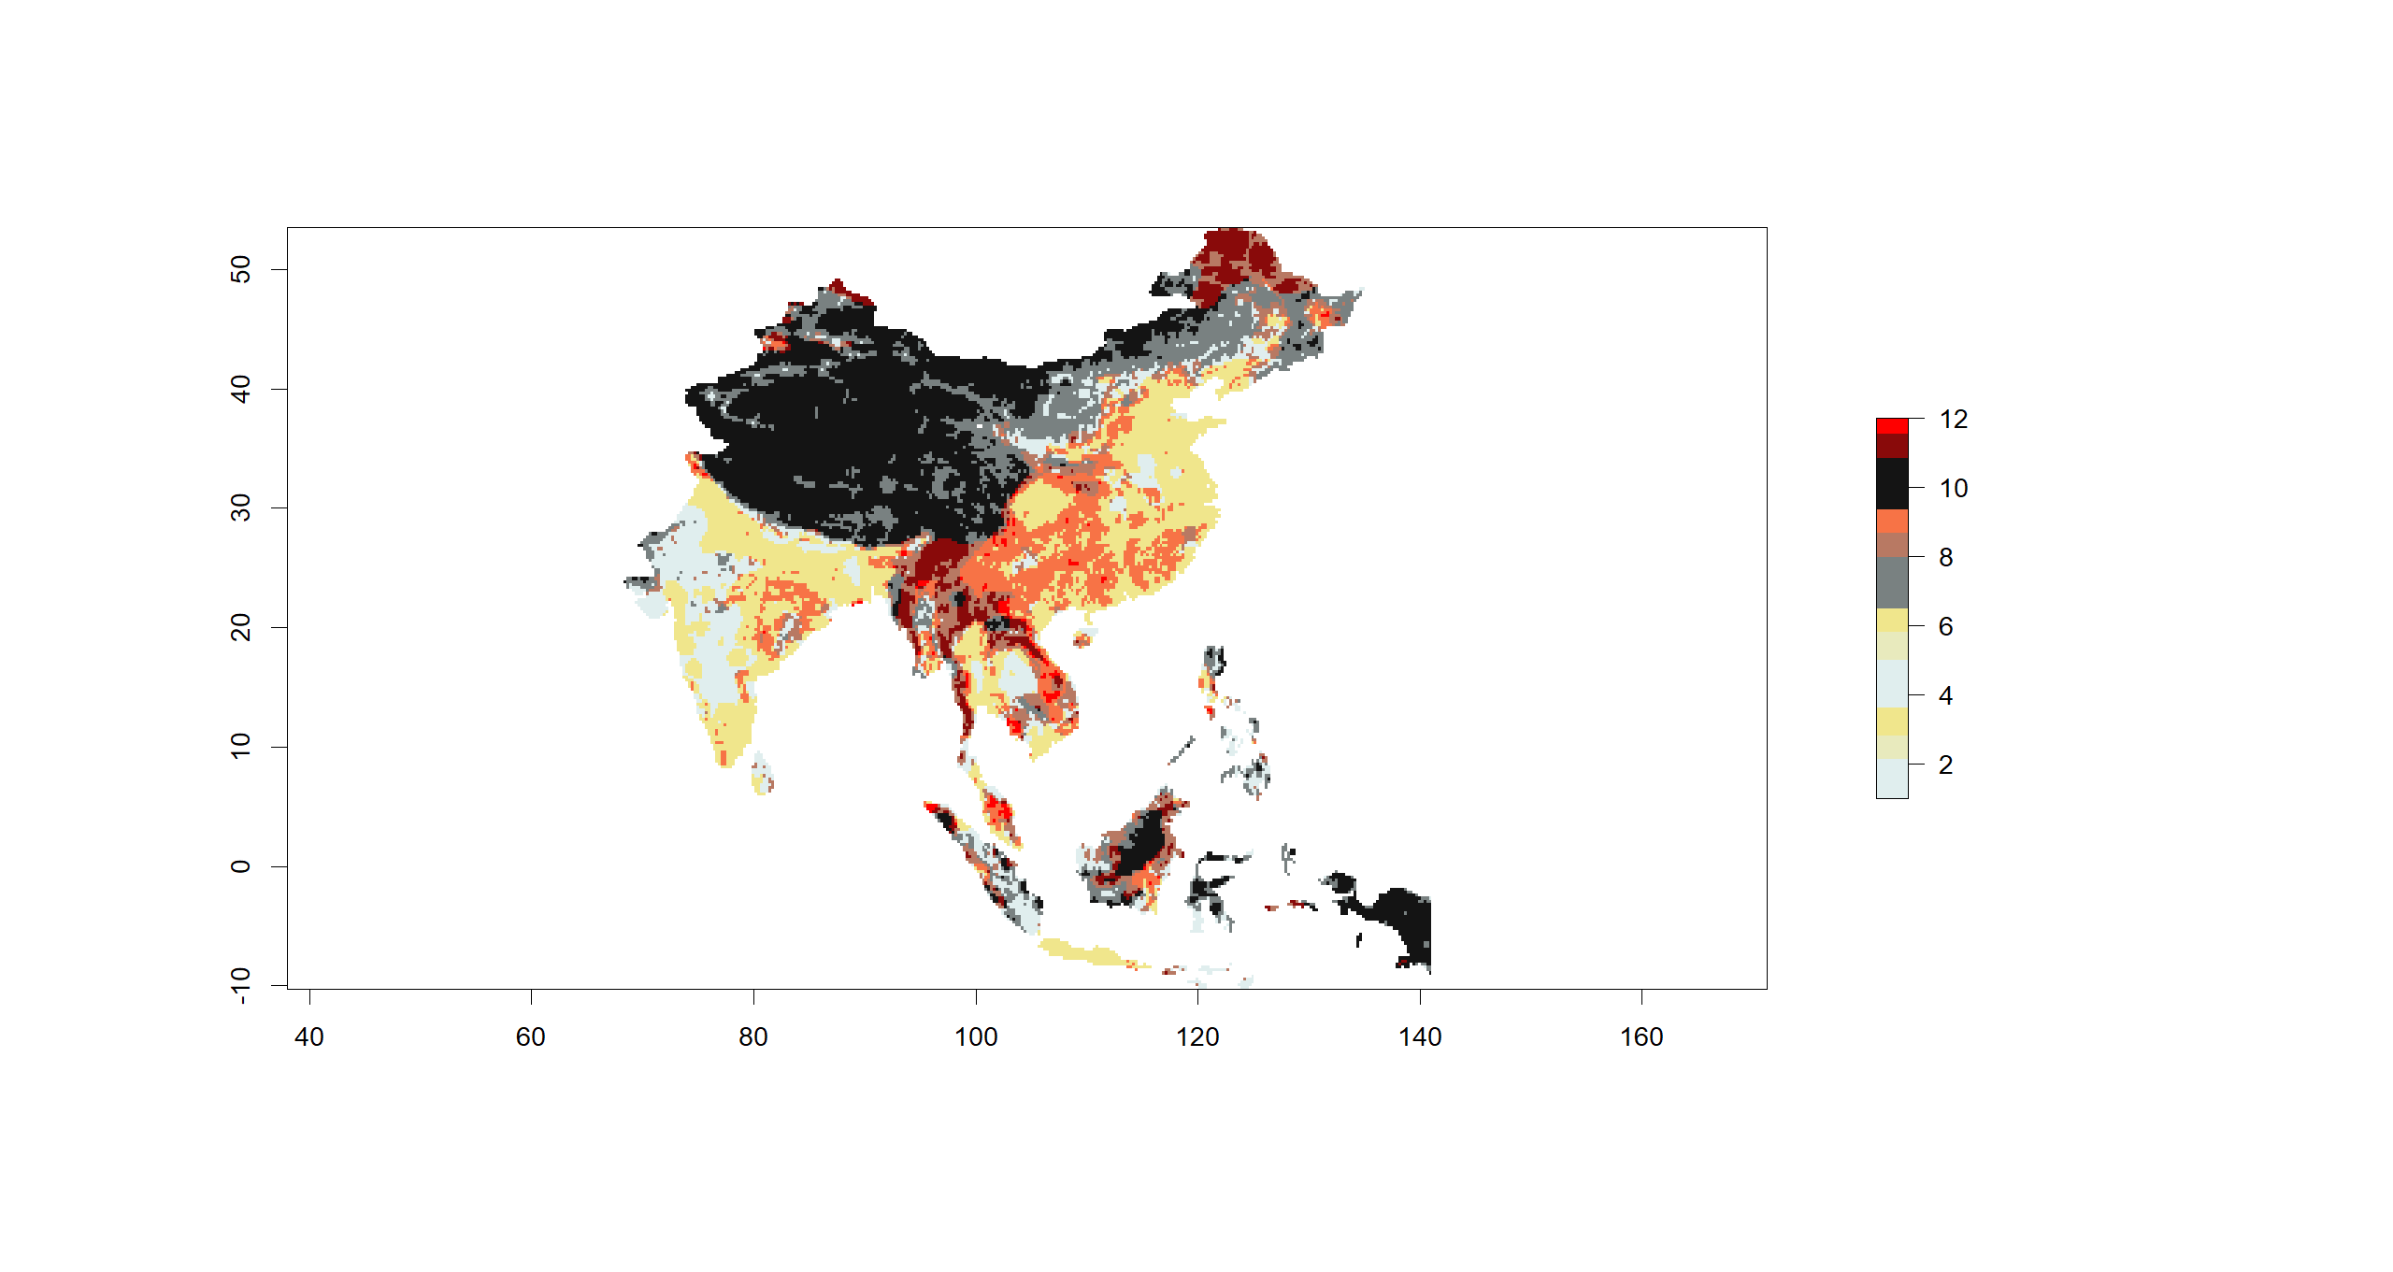
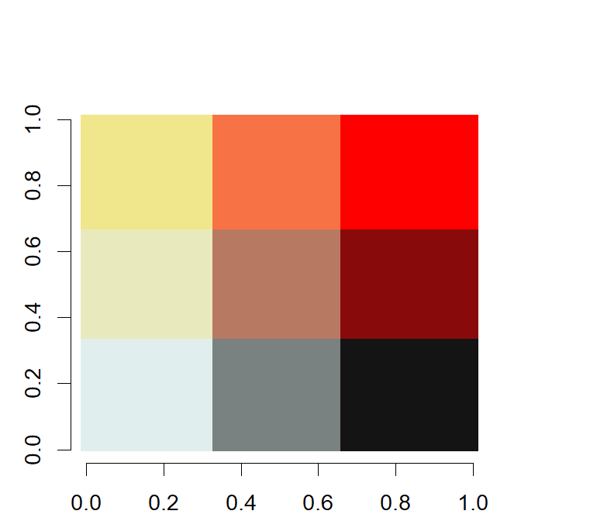
3
9
12
2
8
11
1
7
10

Slide 34
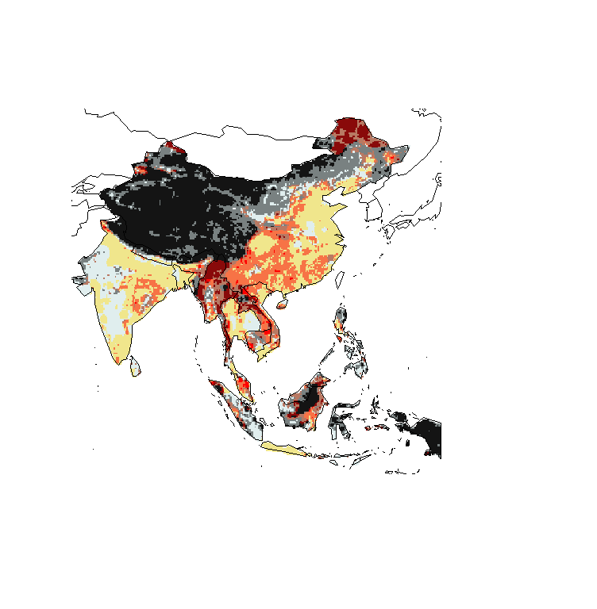
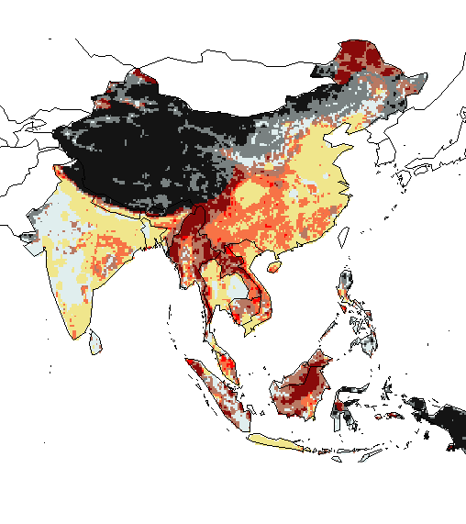
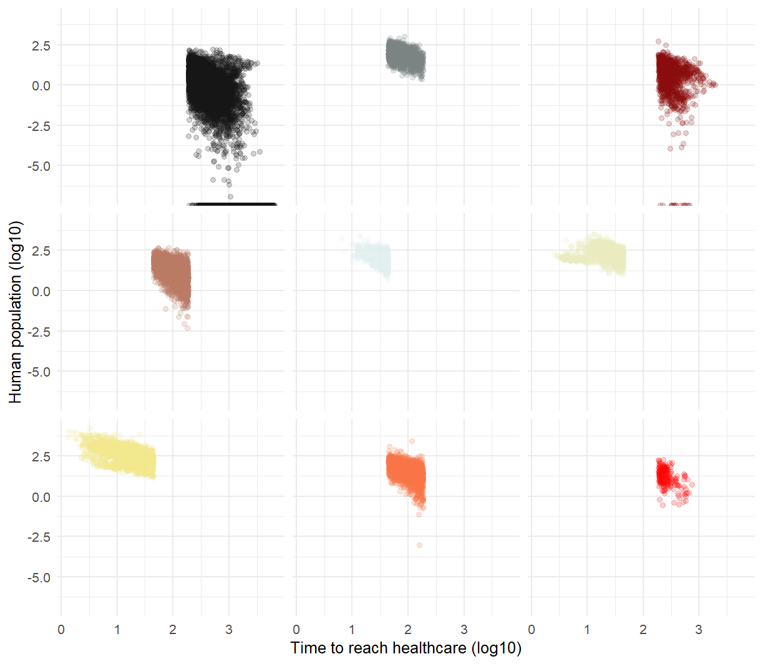

- Hazard: Scenario 1 +
- Hazard: Scenario 2 +
- Time to reach healthcare +
- Time to reach healthcare +

